Slide 1
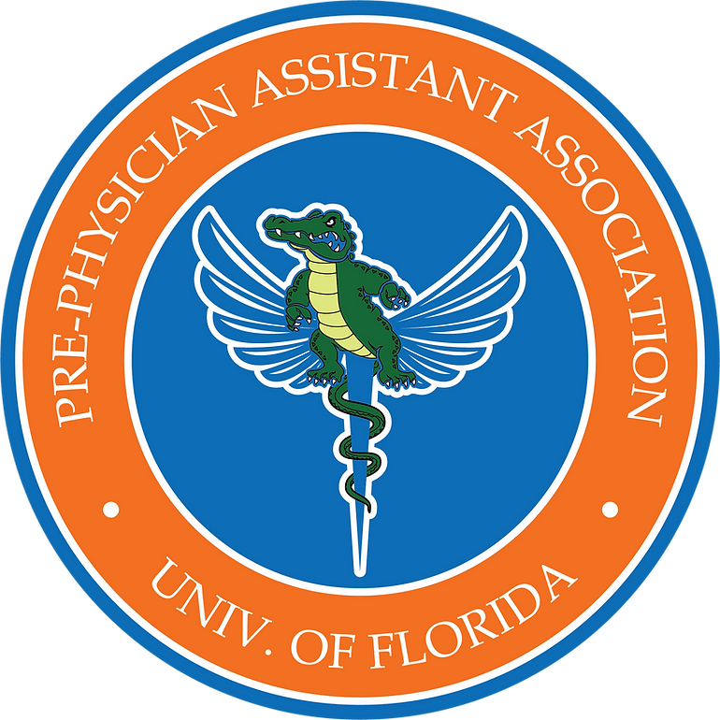
Travis Grant, MS, PA-C Assistant Professor Associate Clinical Director UF School of PA Studies
8/29/22

Slide 2
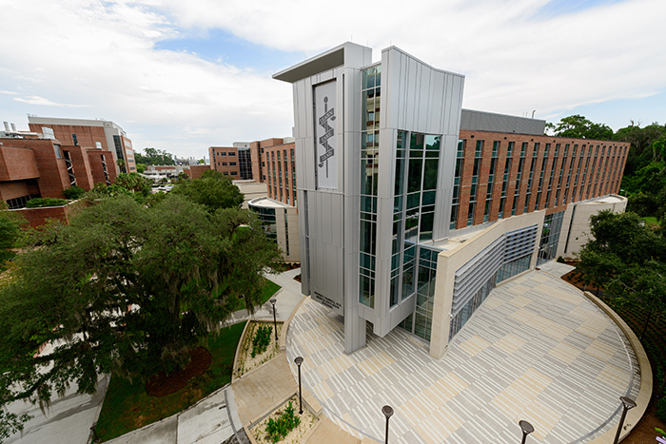

Slide 7
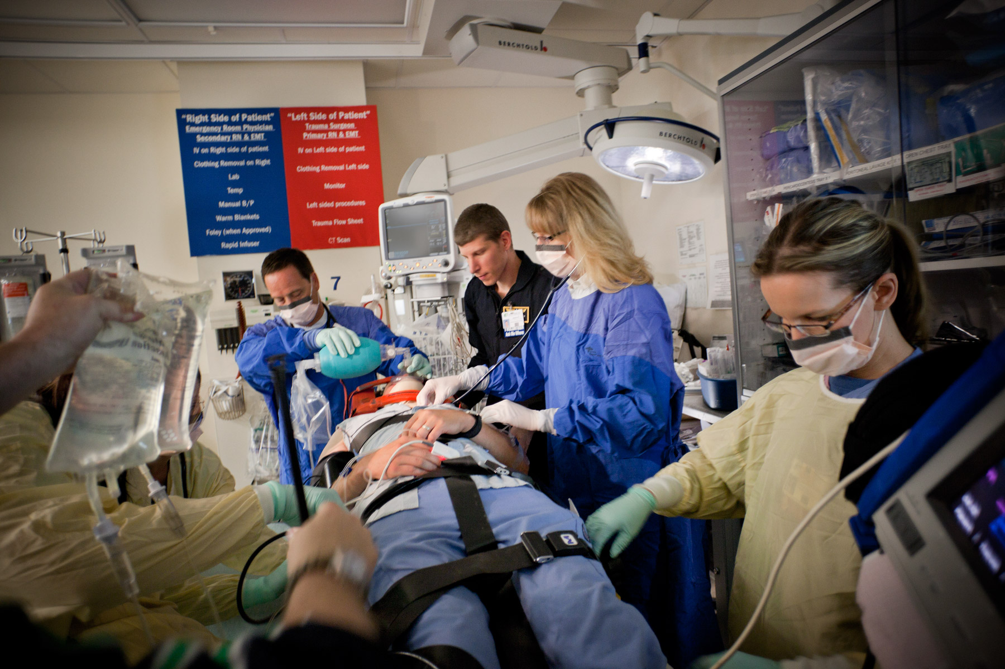

Slide 8
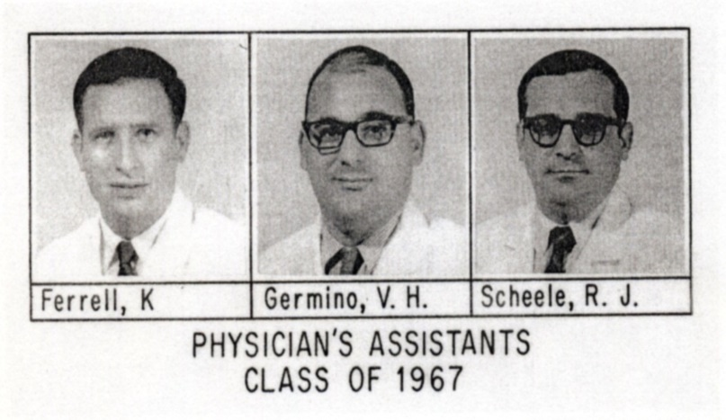
History of the Physician Assistant Profession
1960’s: Uneven distribution of primary care physicians
Idea of “midlevel providers” from the ranks of military Corpsmen returning from Vietnam
1965: Initial PA curriculum based on fast-tracking WWII doctor-training
Dr. Eugene Stead
Duke University
1ST PA CLASS FORMED 57 YEARS AGO
Notes:
Corpsmen didn’t have comparable civilian employment available in the US

Slide 9
PA Profession - 50 years later -
2021: #1 Best Health Care Job and #1 Best Job (US News & World report)
2018: PA degree 8th Best Master’s Degree for jobs (Forbes)
For health care occupations 2014 – 2024: PA profession w/ high expected rate of growth (30%) (Monster.com)

Slide 10
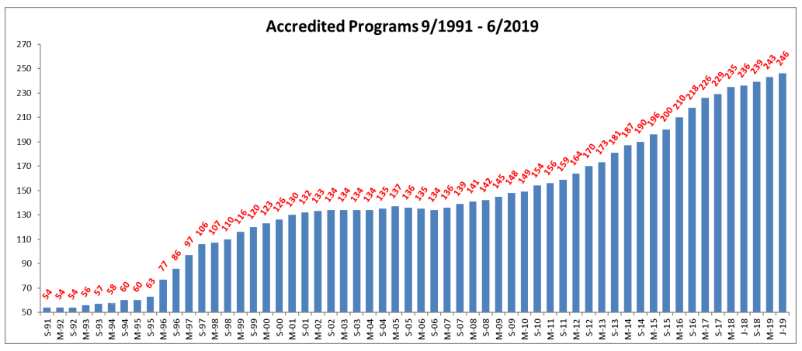
Notes:
Currently 287! 14 in FL, several provisional

Slide 11
What is a Physician Assistant?
PAs . . .
Cost-effective medical model
Interdependent practice with physicians
National certification
State licensure
Collaborative member of interprofessional team
Care for new/existing patients in all settings
Hospital/nursing home
Clinic/office setting
Rural/Health departments
Take med histories/conduct physical exams
Order/interpret tests
Diagnose and treat
Prescribe
Perform minor procedures
1st Assist in surgery
Counsel
Notes:
Collaborative member of HC team: PA provides services traditionally provided by the physician
Scope of practice varies by setting, specialty, and responsibilities delegated by physician partner
Settings for PA care/scope: PAs perform extensive range of medical services in nearly every med/surg specialty

Slide 12
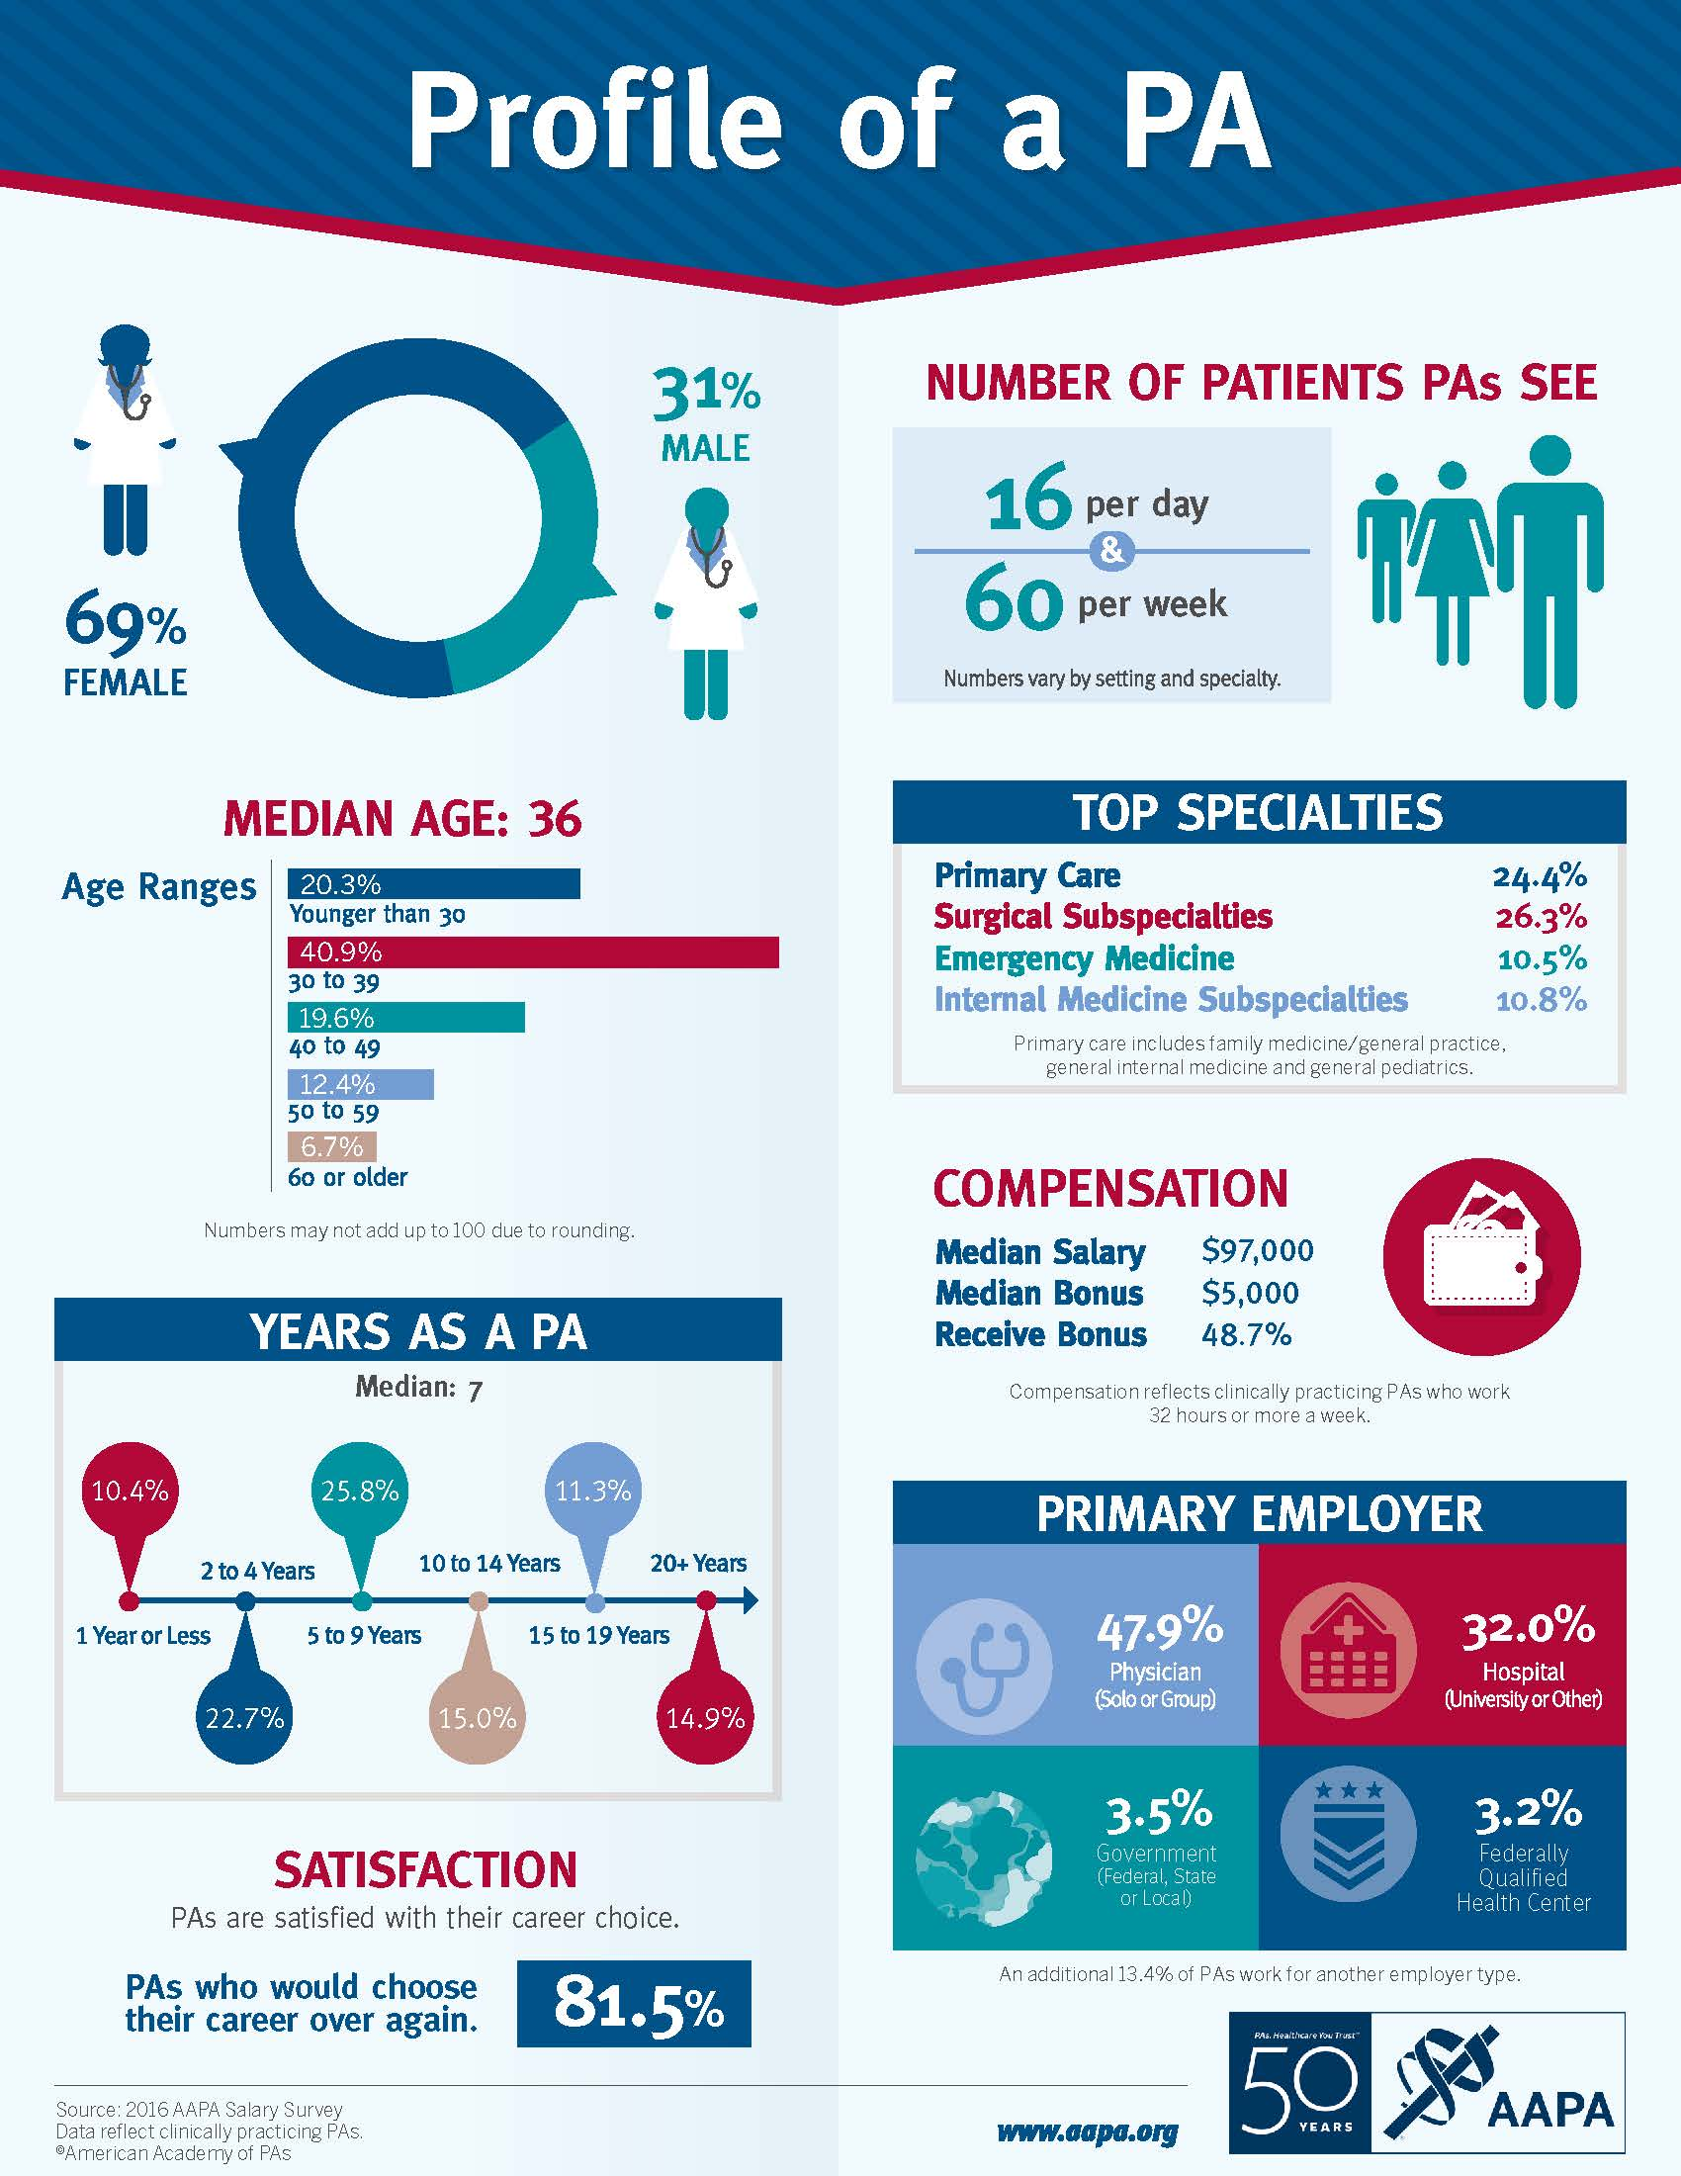
Notes:
Median salary now closer to 115K, new graduate around 100k

Slide 13
What Does It Take to Work as a PA?
Graduate from nationally accredited program
Pass boards: national certifying exam (PANCE)
State licensure to practice
Maintain state licensure to practice
100 hours CME every 2 years
Pass boards: national recertification exam (PANRE) every 10 years
Notes:
all PAs must be nationally certified (pass boards) to be licensed in their state
All states require PAs to be licensed

Slide 14
Read about more PAs and the exciting work they are doing!
Notes:
Read about more PAs and the exciting work they are doing!
http://www.nccpa.net/pas-do-that

Slide 15
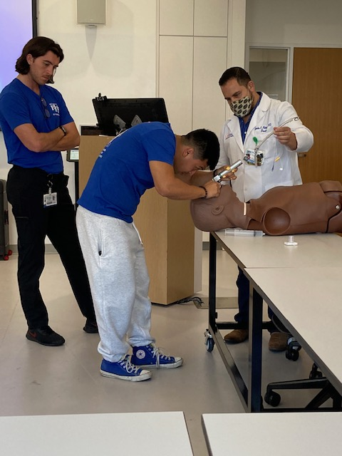

Slide 16
UF School of Physician Assistant Studies
24 month curriculum
12 mo coursework
Anatomy, physiology, medicine, pharmacology
EKG, radiology, clinical procedures, evidence-based medicine
12 mo clinical rotations
Medicine, Primary Care, Surgery, Critical Care, Women’s Health, Psychiatry, Emergency Medicine, (3) Electives
Differential dx (disease processes), physical diagnosis
Master’s Capstone Project

Slide 17
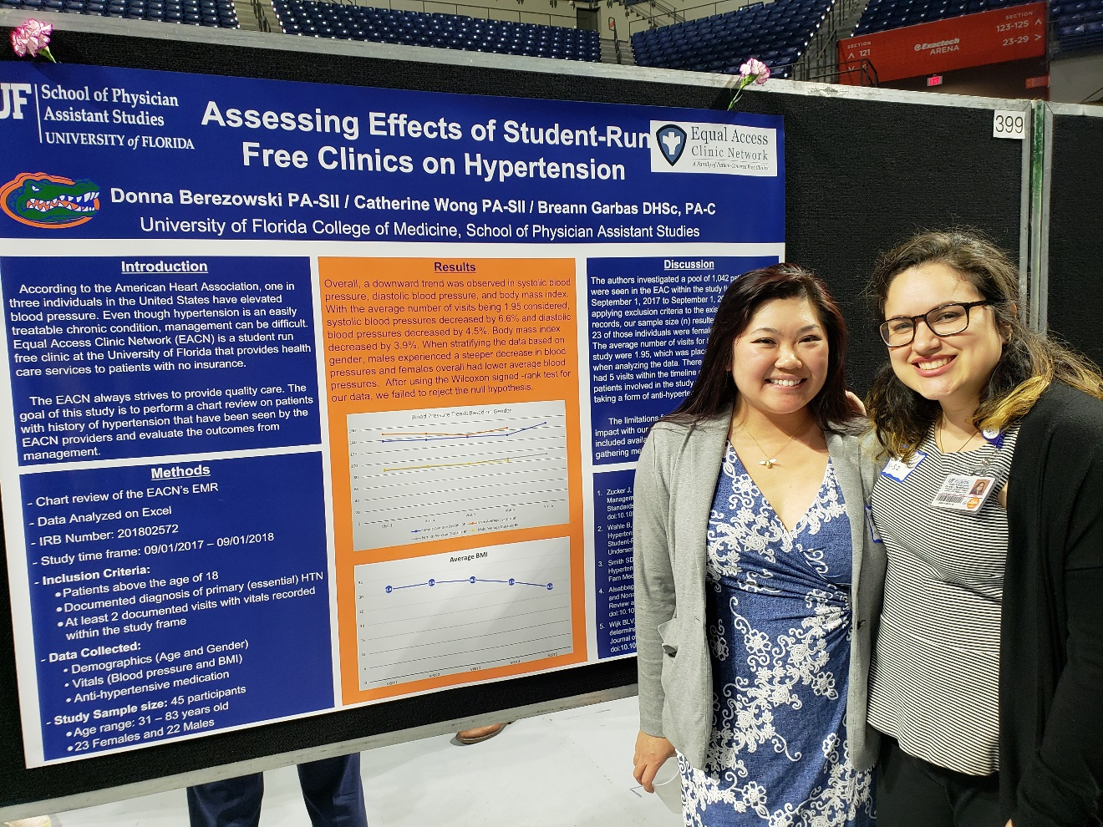
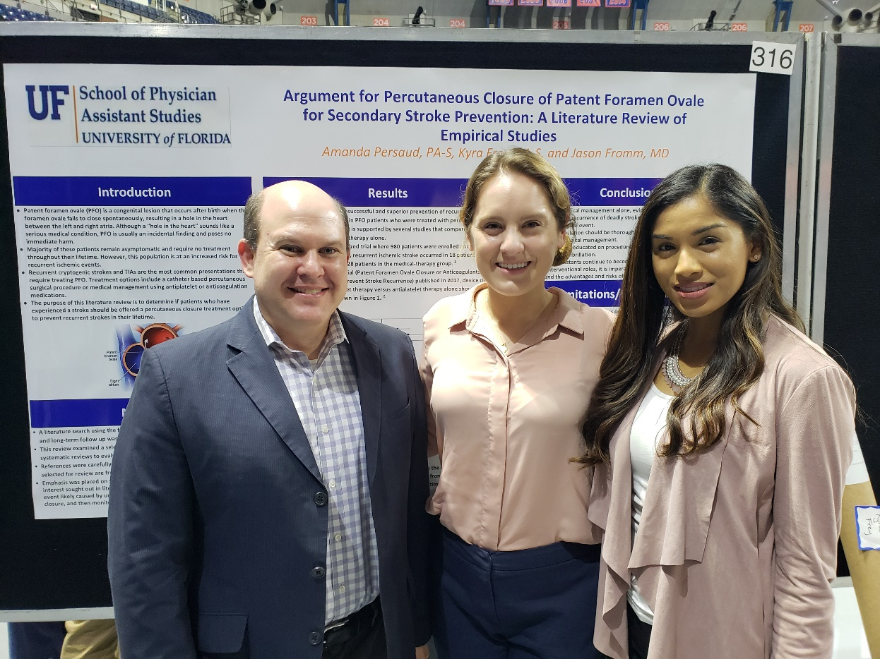
UF College of Medicine
Research Poster Session
February 19, 2019
Exactech Arena

Slide 18
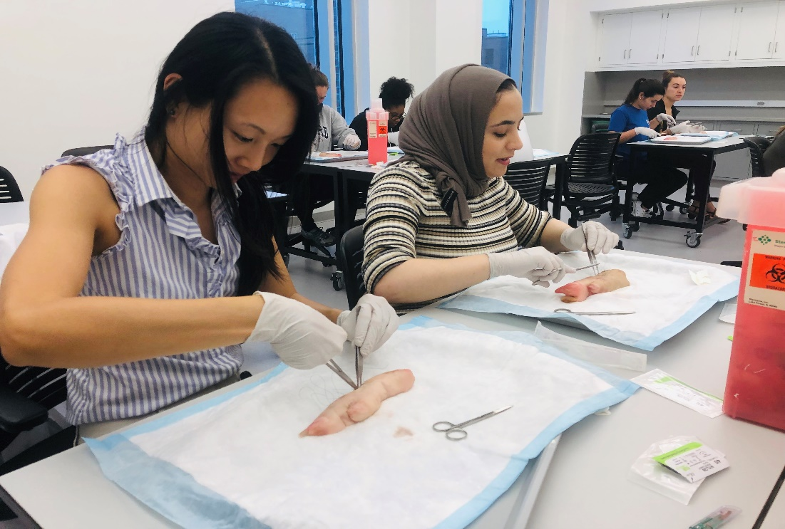
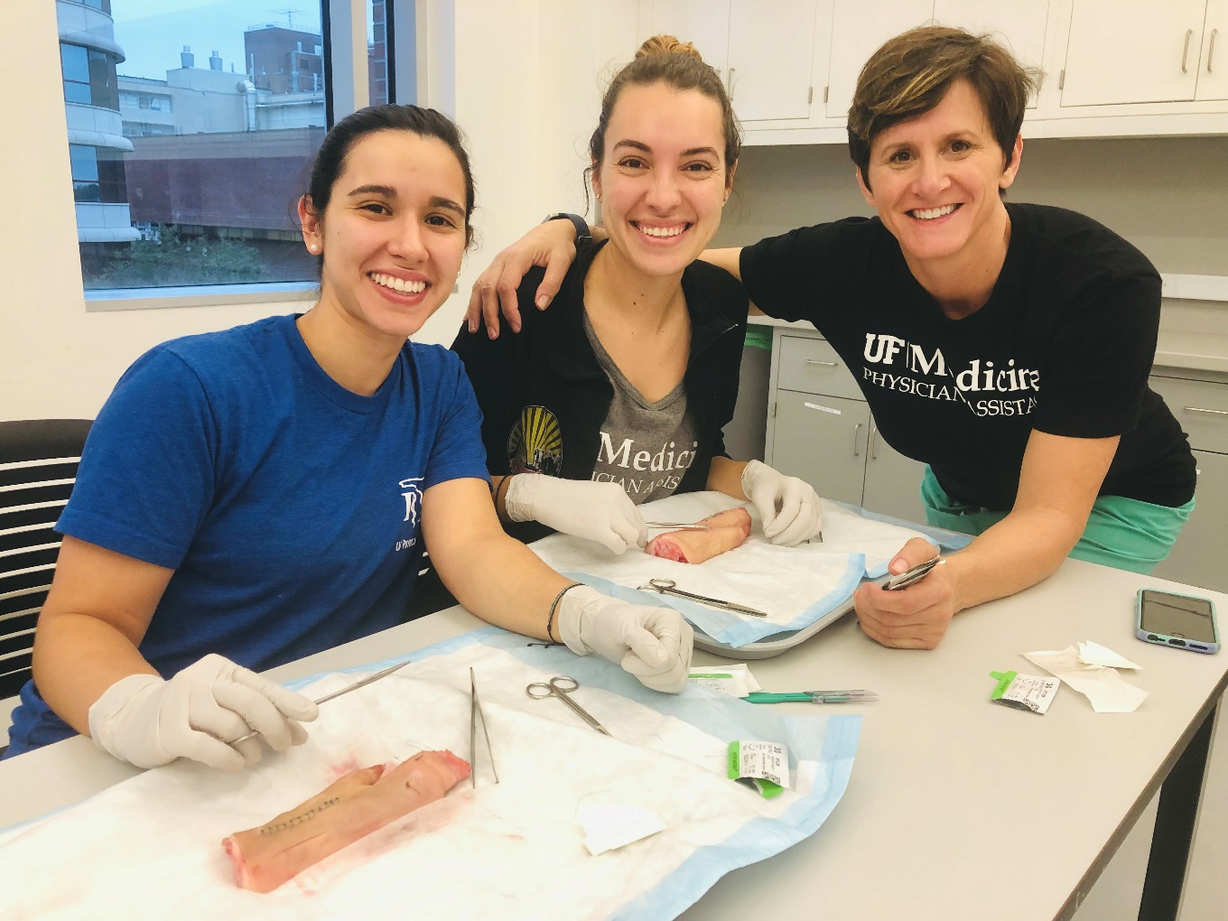
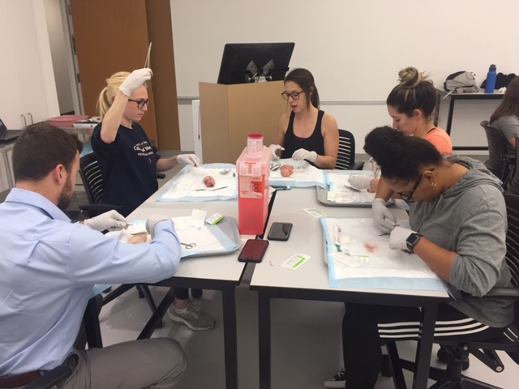
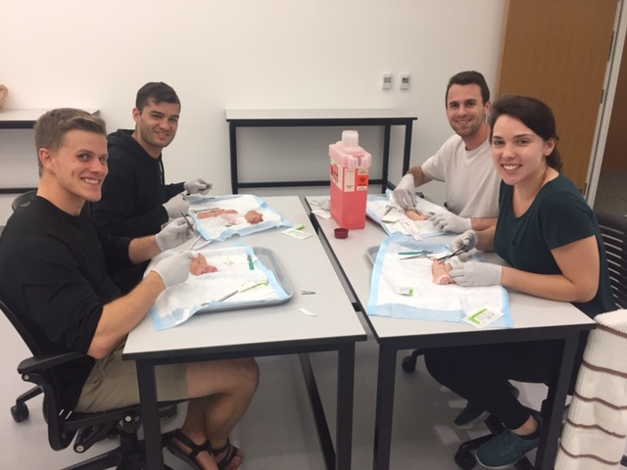
PA SURGERY CLUB

Slide 19
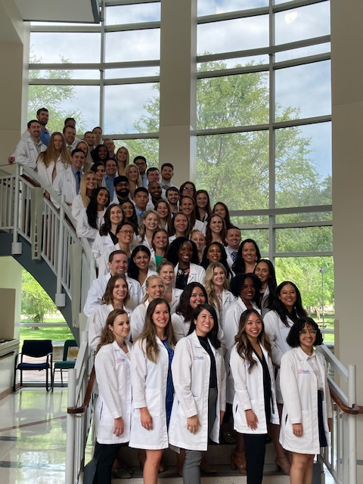

Slide 20
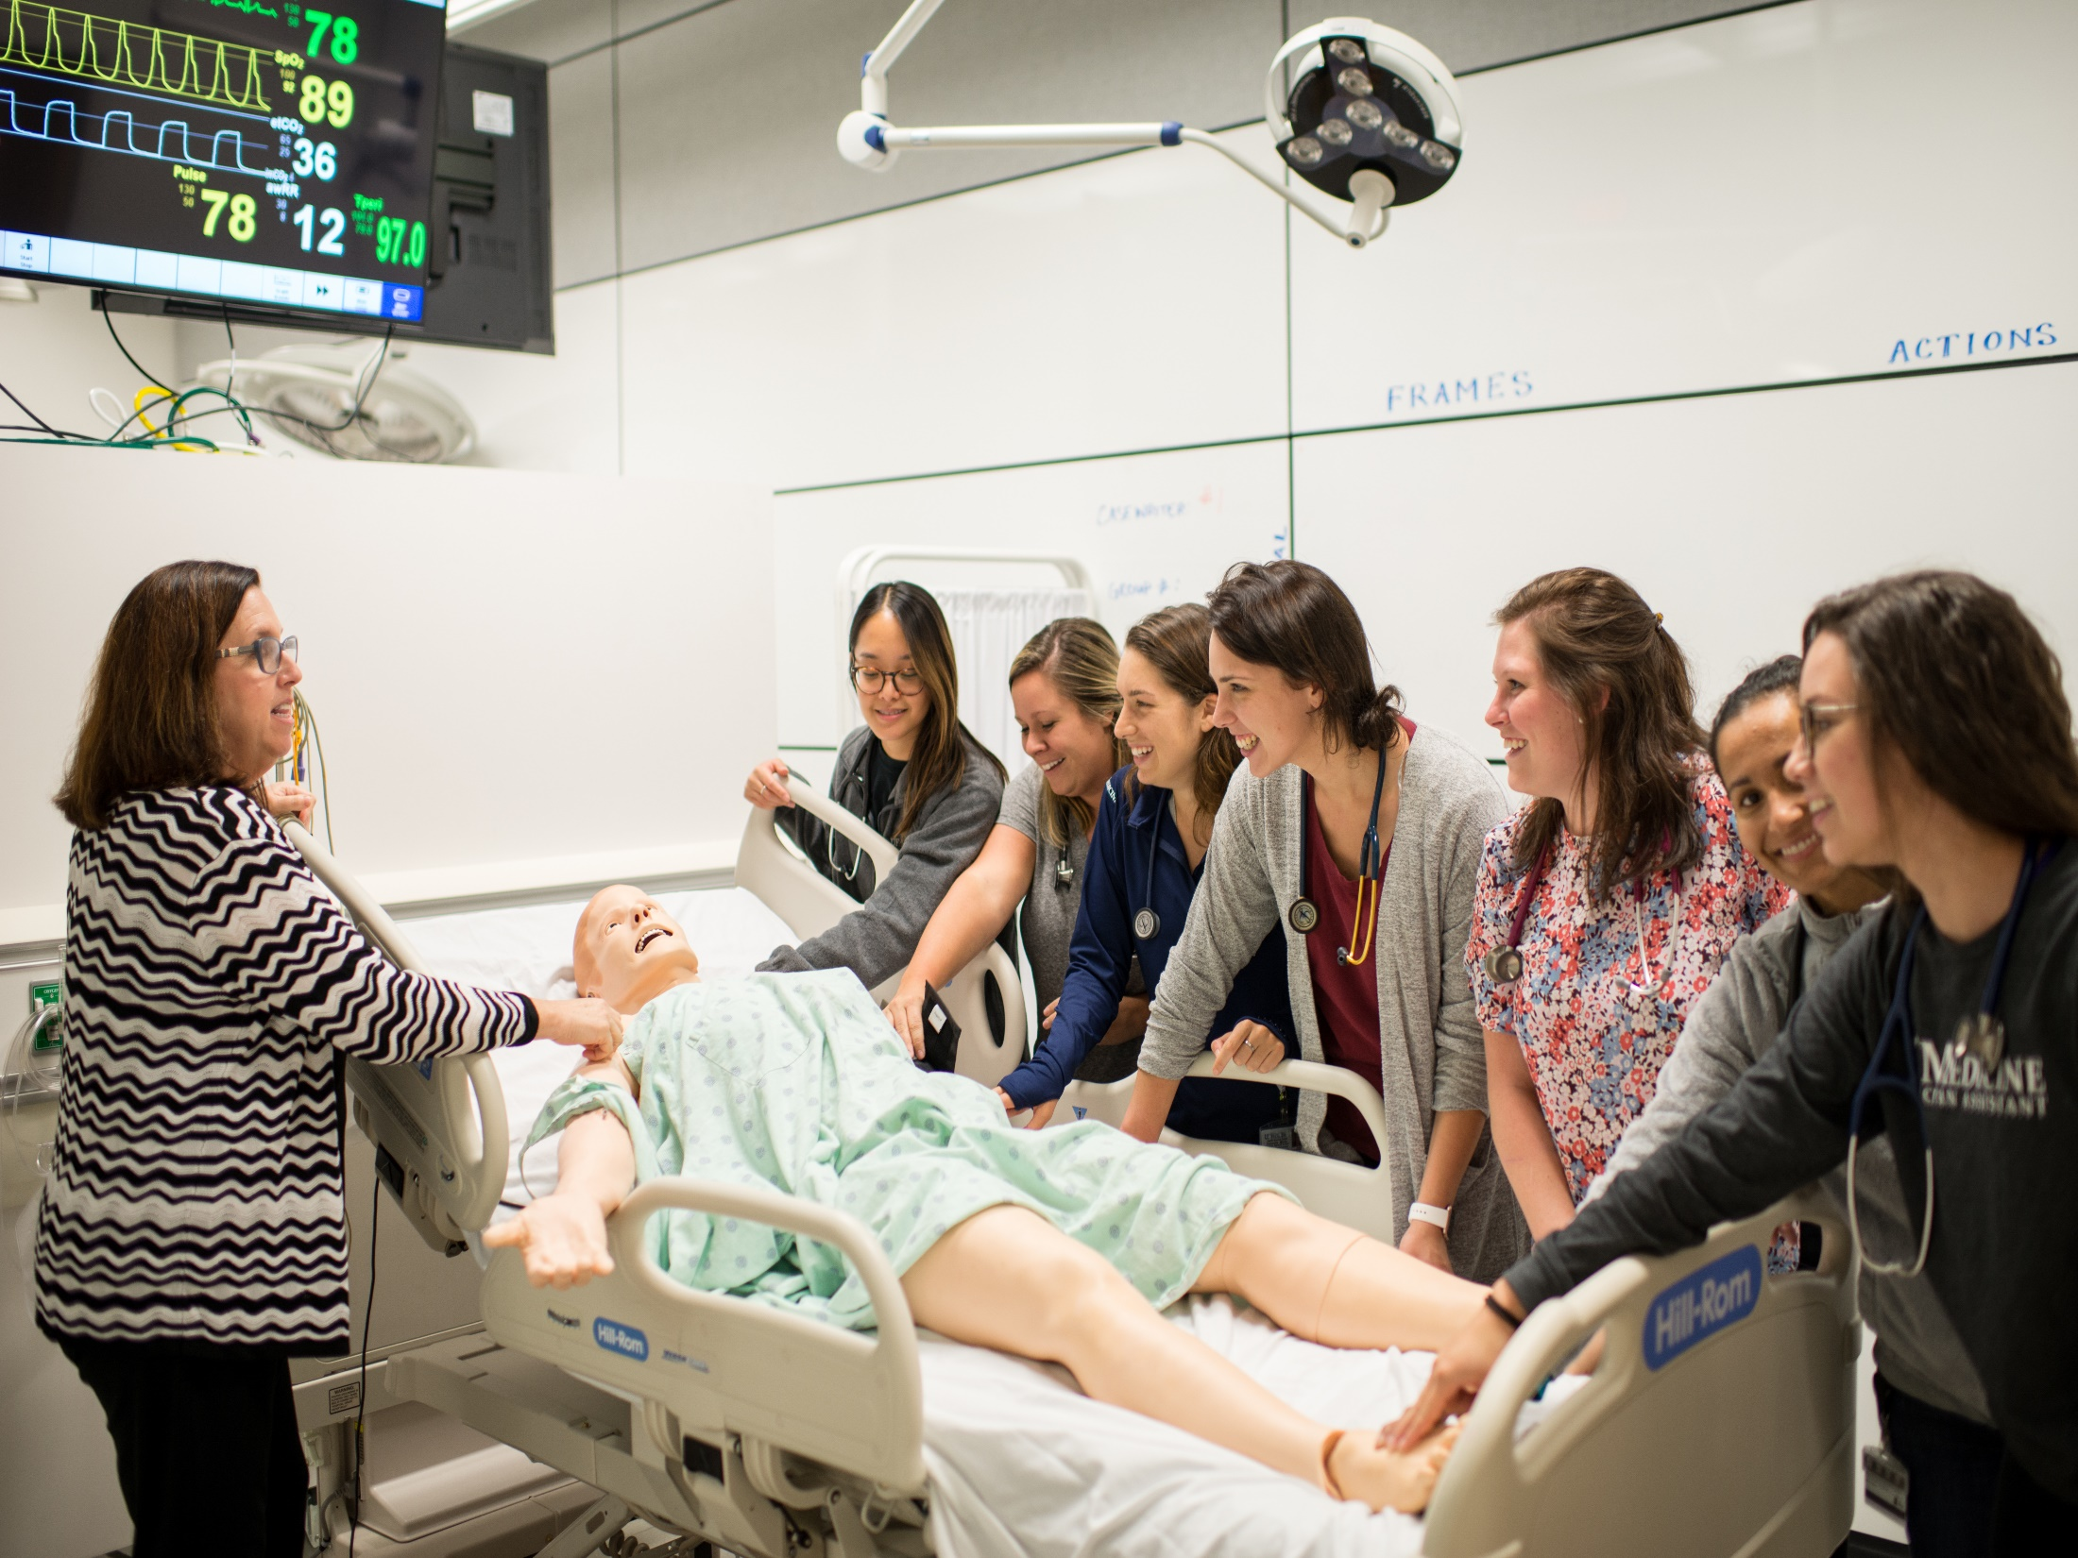

Slide 21
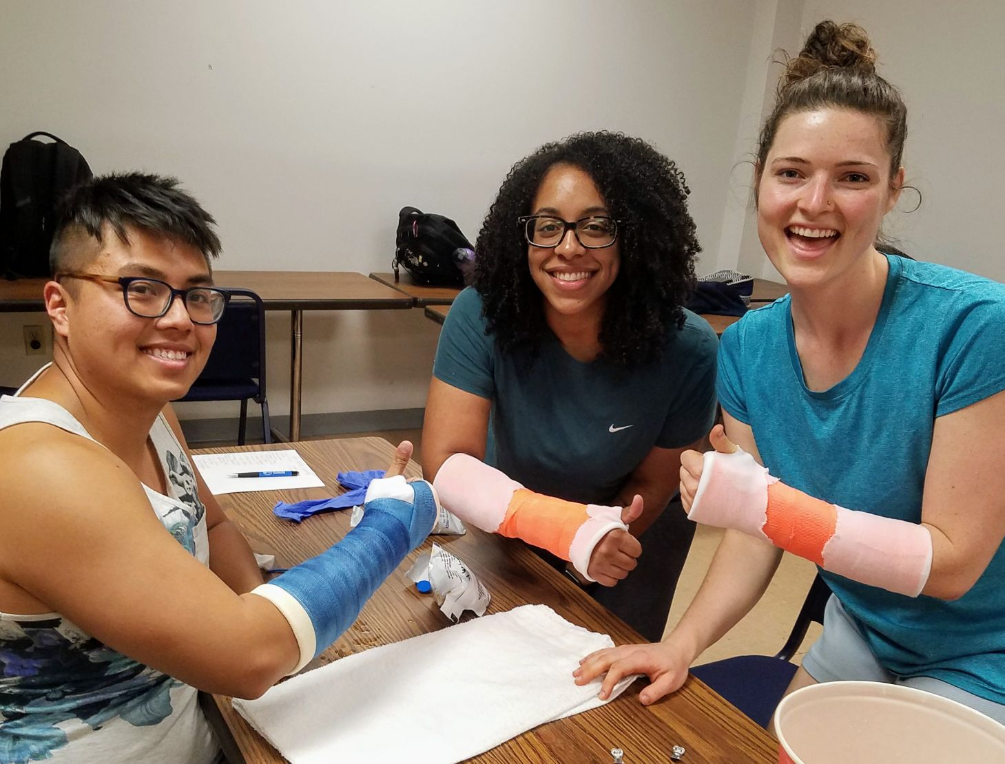

Slide 22
How Can I be Competitive for PA School?
Experience valued.
Direct patient care
Health related experience/ PA shadowing
Leadership
Volunteerism
Notes:
Bachelors plus prereqs plus…

Slide 23
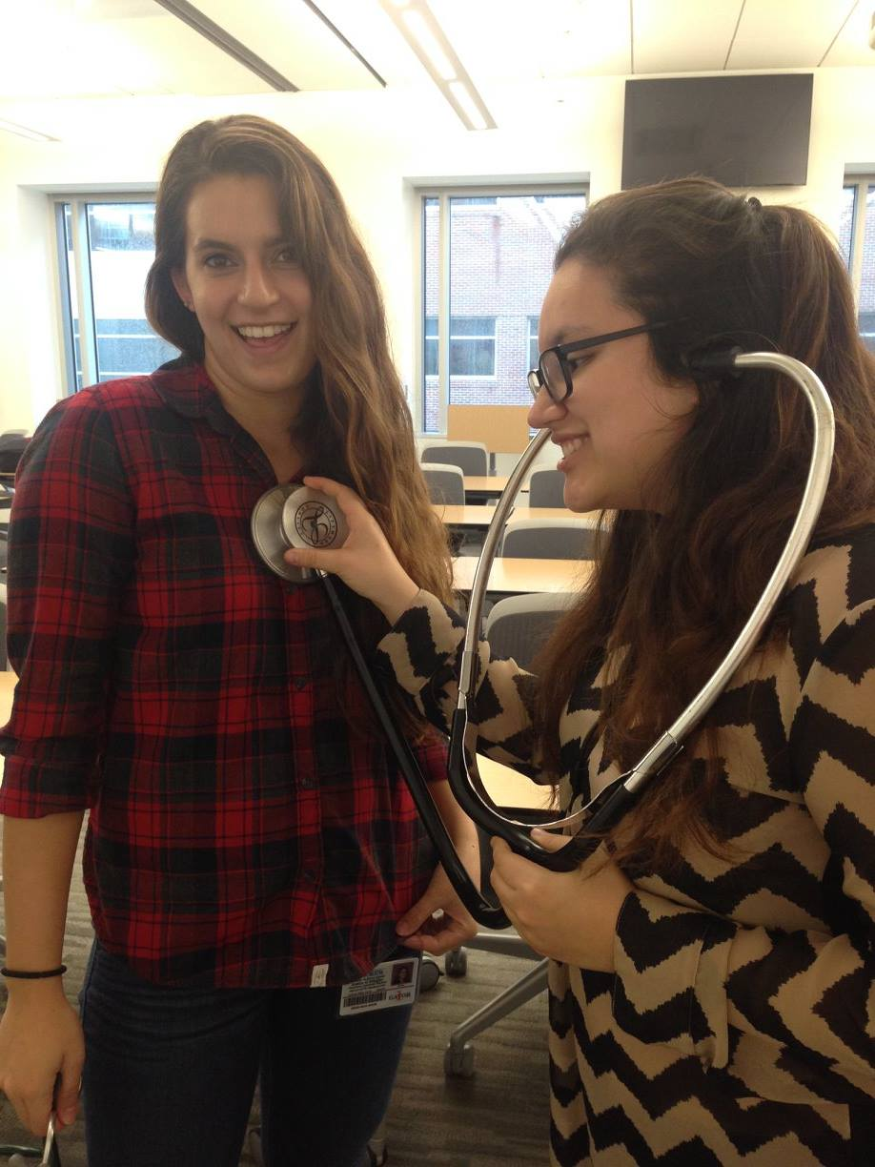
Direct Patient Care (DPC) before PA school
Medical assistant
Nursing assistant
EMT/paramedic
ER tech
Scribe

Slide 24
How Can I be Competitive for PA School?
Experience valued.
Direct patient care
Health related experience/PA shadowing
Leadership
Volunteerism

Slide 25
FAQ: Why is shadowing a PA important?
To understand:
The breadth of medicine which PAs practice
Relationships: PA-patient, PA-MD PA-team
What working as a PA is really like

Slide 26
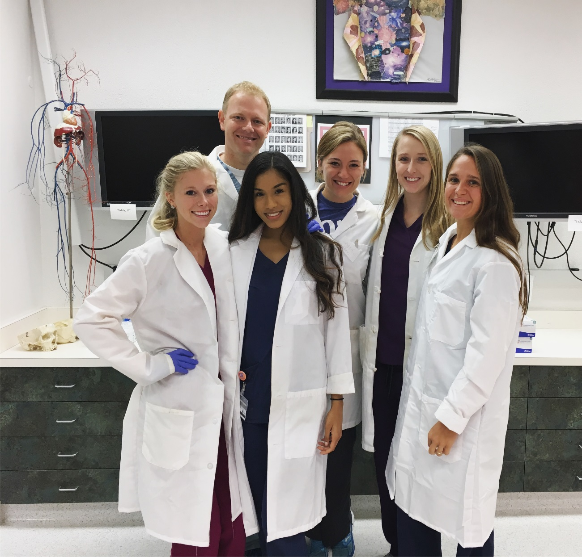
How Can I be Competitive for PA School?
Experience valued.
Direct patient care
Health related
experience/
PA shadowing
Leadership
Volunteer

Slide 27
Physician – PA Teams
PAs
Provide quality of care comparable to that of physicians
Enhance coordination of care
In practice with physicians PAs provide more cost-effective care than practices without PAs
PAs
Increase patient satisfaction
Create access to healthcare
Elevate health outcomes
American Academy of Physician Assistants www.aapa.org

Slide 28
Compare and Contrast PAs and Physicians
PAs do much of the same work of the physician
Evaluate, diagnose and treat
Prescribe medications, therapies
Perform procedures; 1st assist in the OR
PA Education shorter . . .
Master’s degree: 24-27 months
Physician supervision: MD/ PA a collaborative team . .
but PAs can work autonomously

Slide 29
Compare and Contrast PAs and Nurse Practitioners
PA education model: medical
NP education model: nursing/preventive health
PAs are educated in general medicine
NPs are educated in advanced nursing practice
PAs are trained in all areas of medicine
NPs are trained in a chosen population focus; a track
Notes:
NP training: choose Family/Adult/Gerontology, Neonatal, Peds, Women’s Health, Psych

Slide 30
Helpful Resources
UF School of Physician Assistant Studies UF PA
www.pa.med.ufl.edu
American Academy of Physician Assistants AAPA
www.aapa.org
Florida Academy of Physician Assistants FAPA
www.fapaonline.org
Physician Assistant Education Association PAEA
www.paeaonline.org

Slide 31
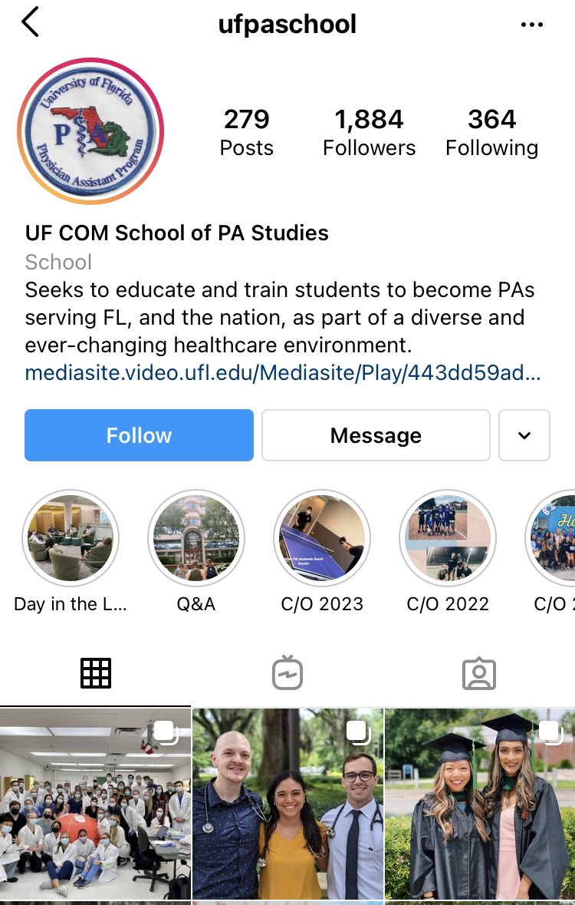

Slide 32
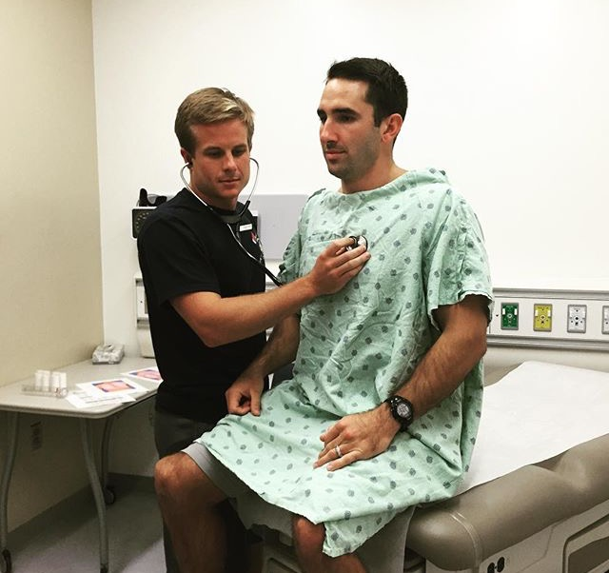
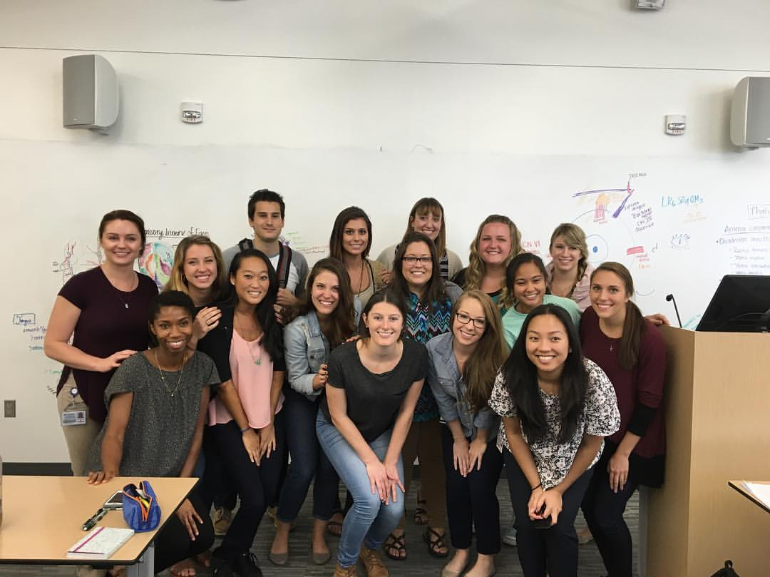
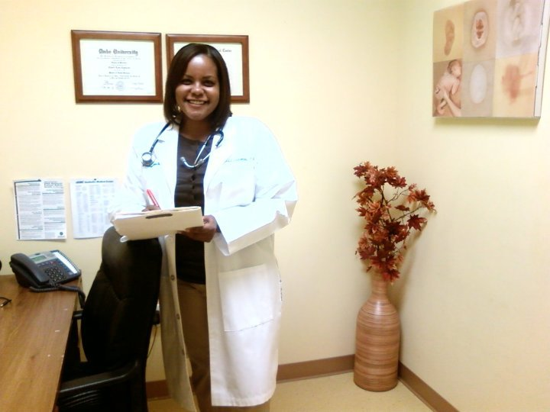
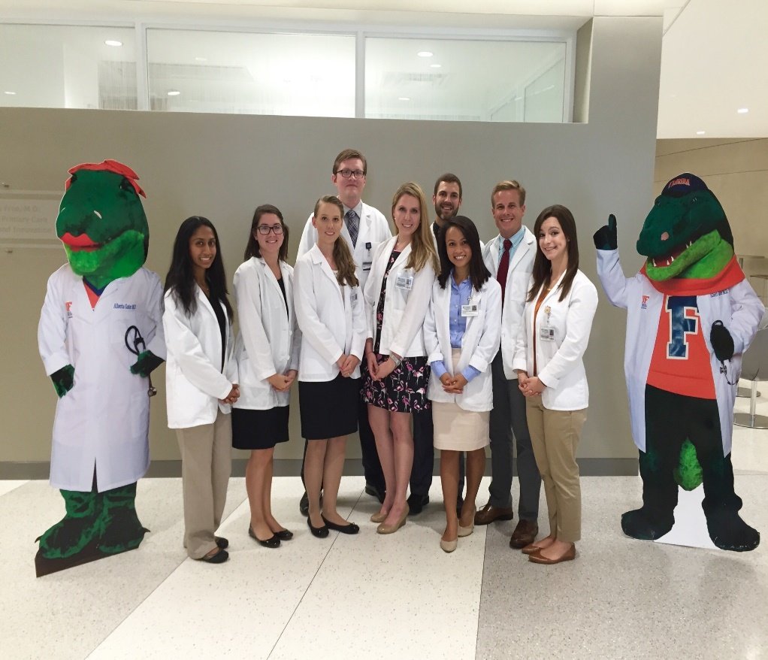
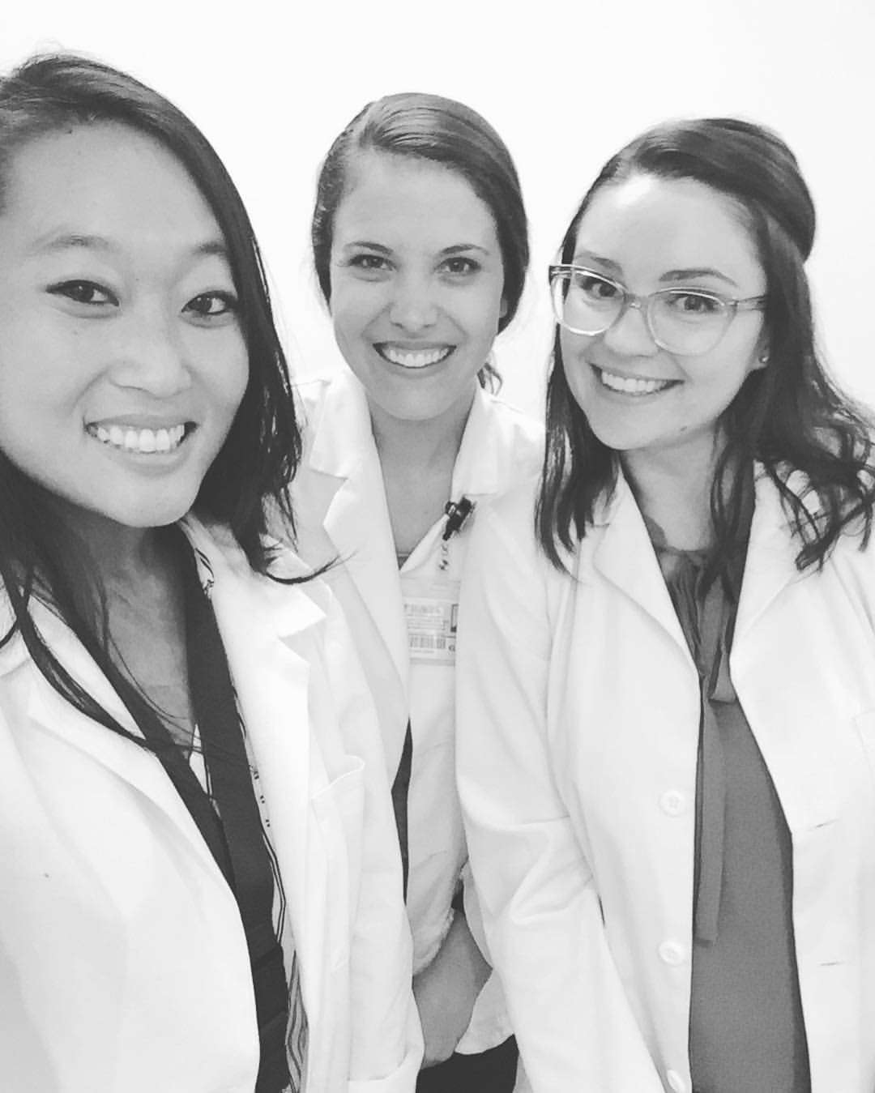
This Could Be You!

Slide 33
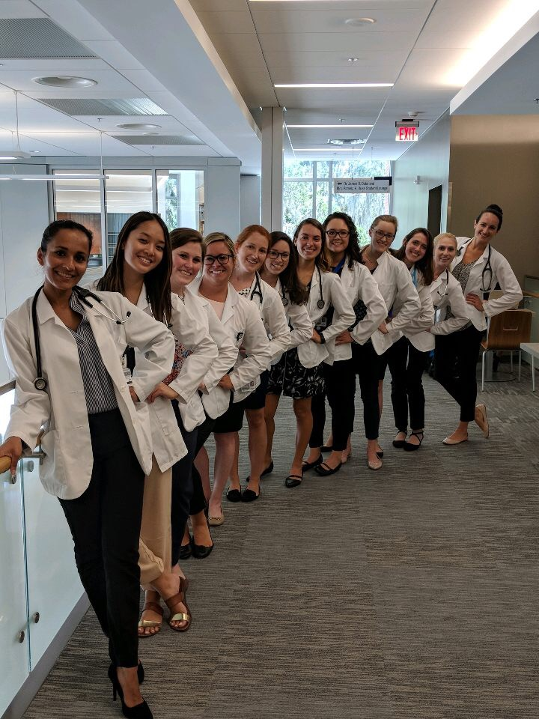
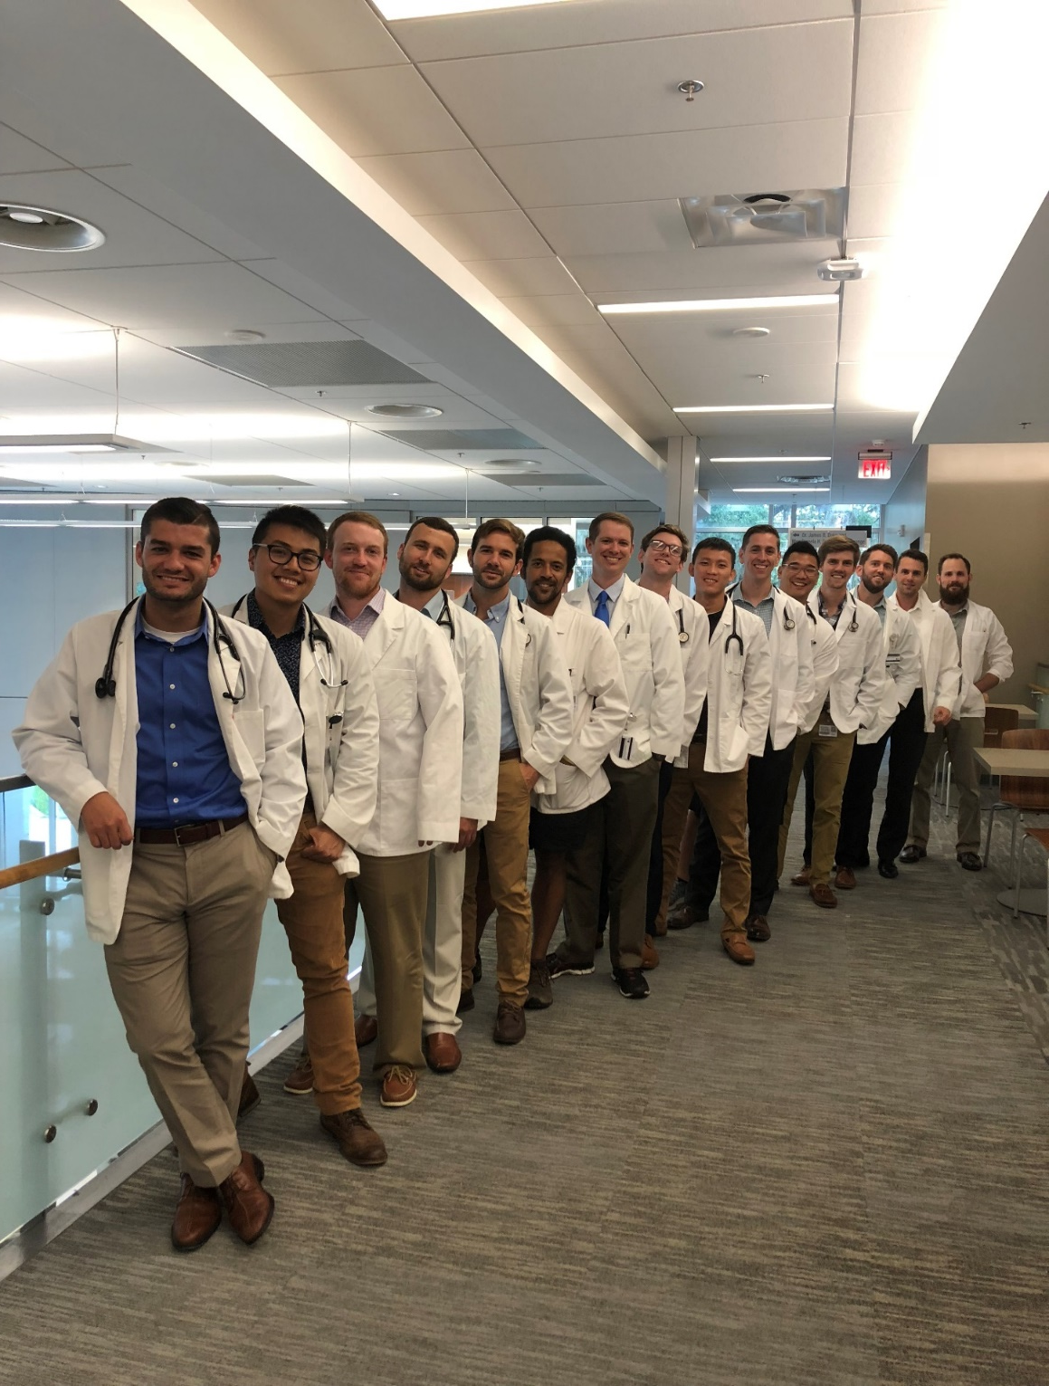

Slide 34
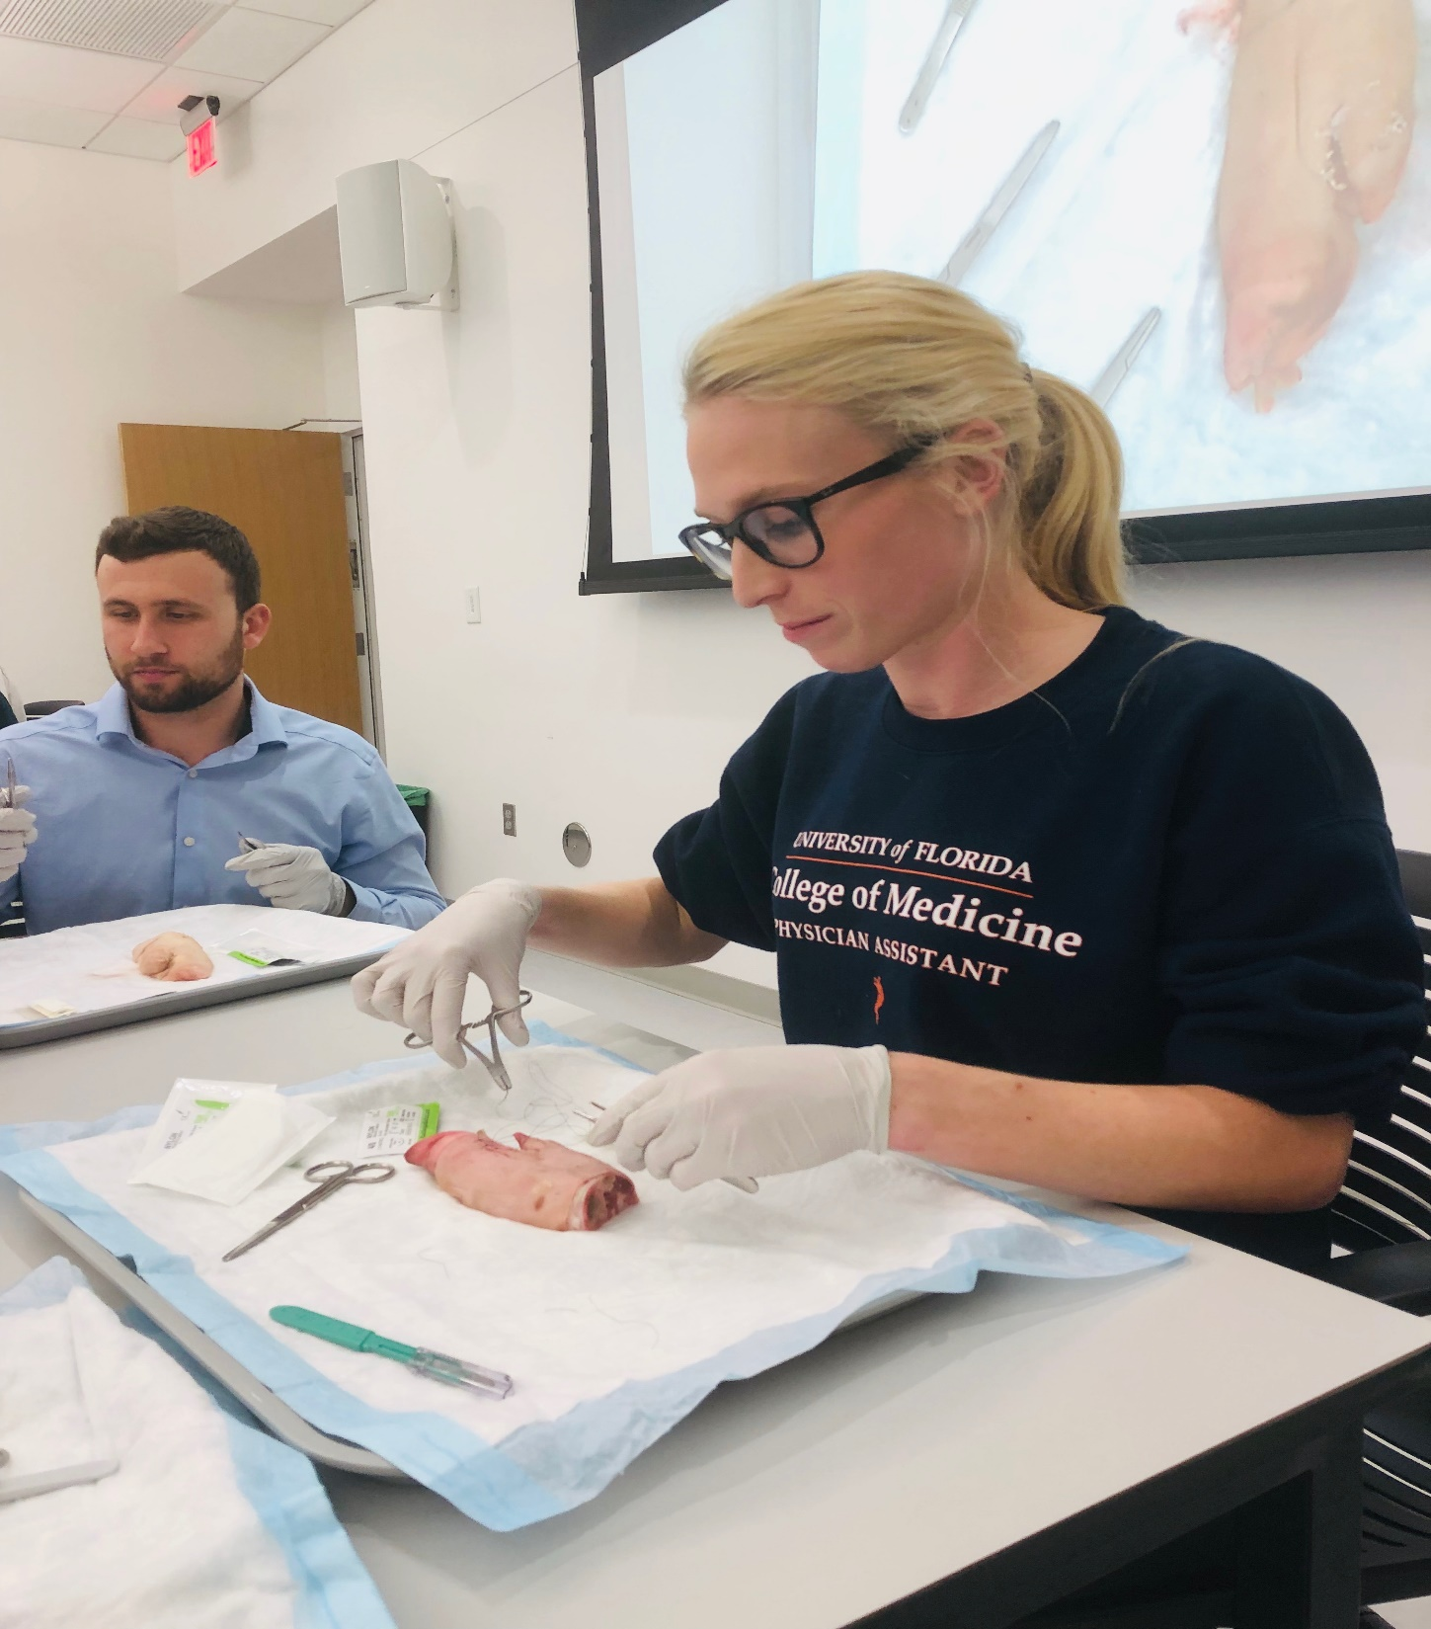

Slide 35
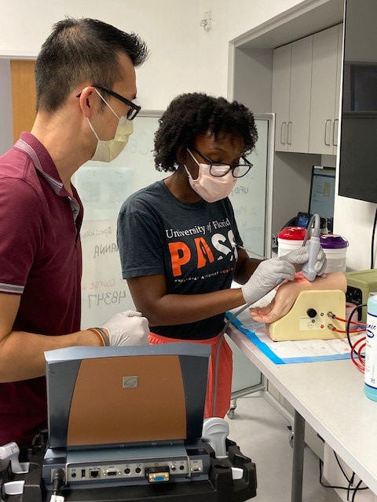
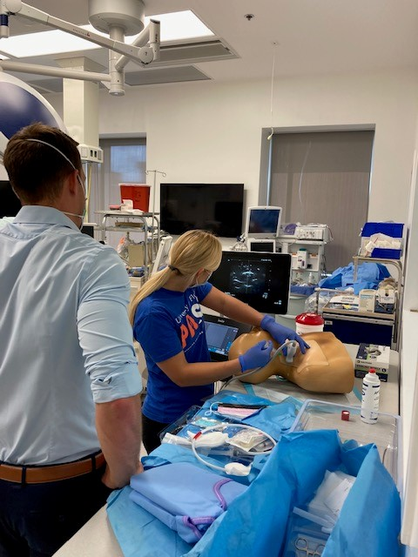
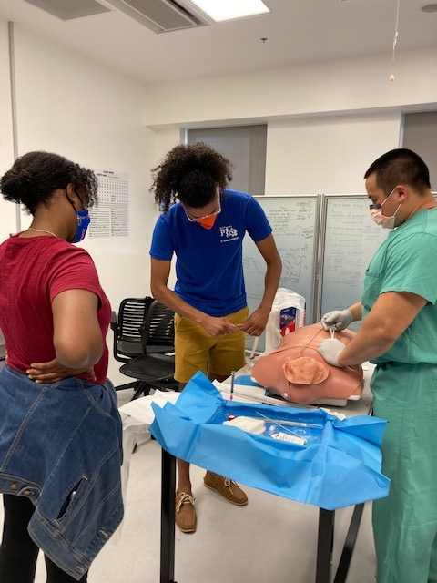

Slide 36
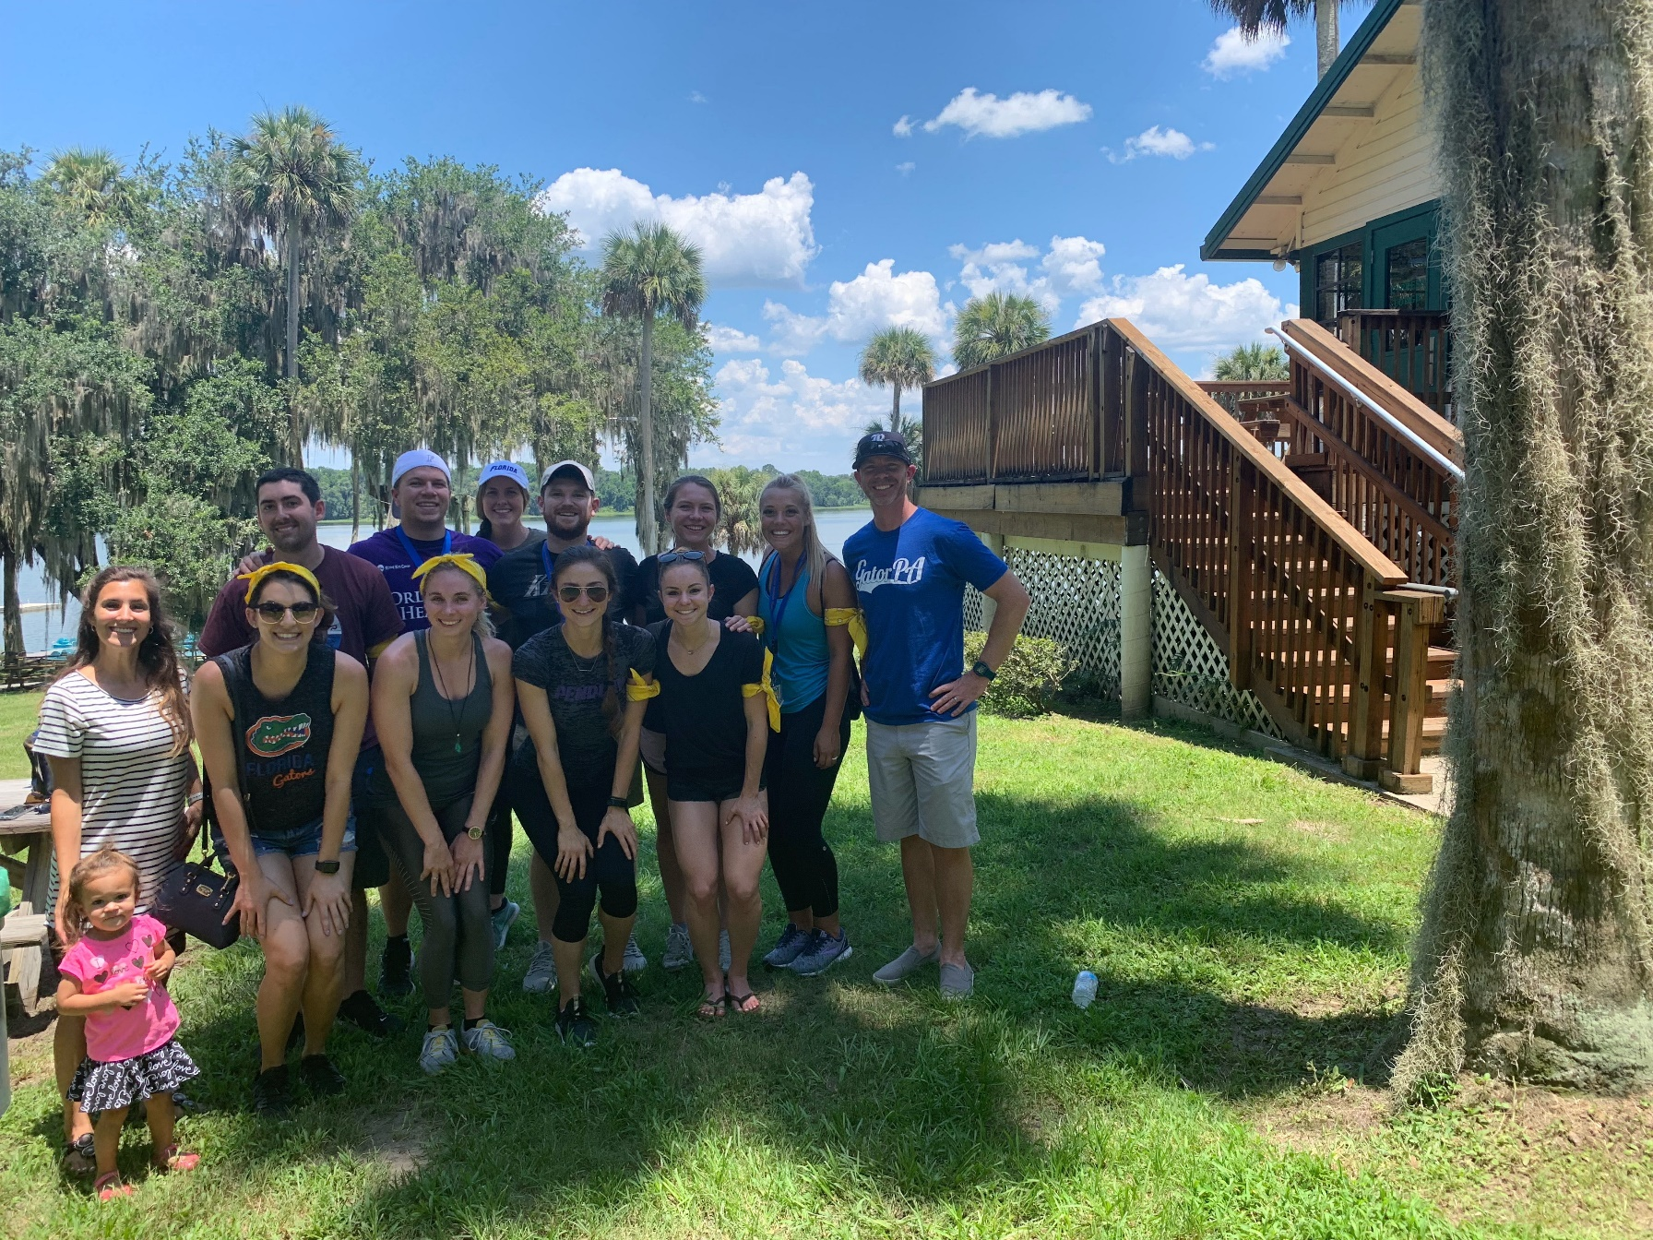

Slide 38
Questions?
travis.grant@pap.ufl.edu

