Slide 1
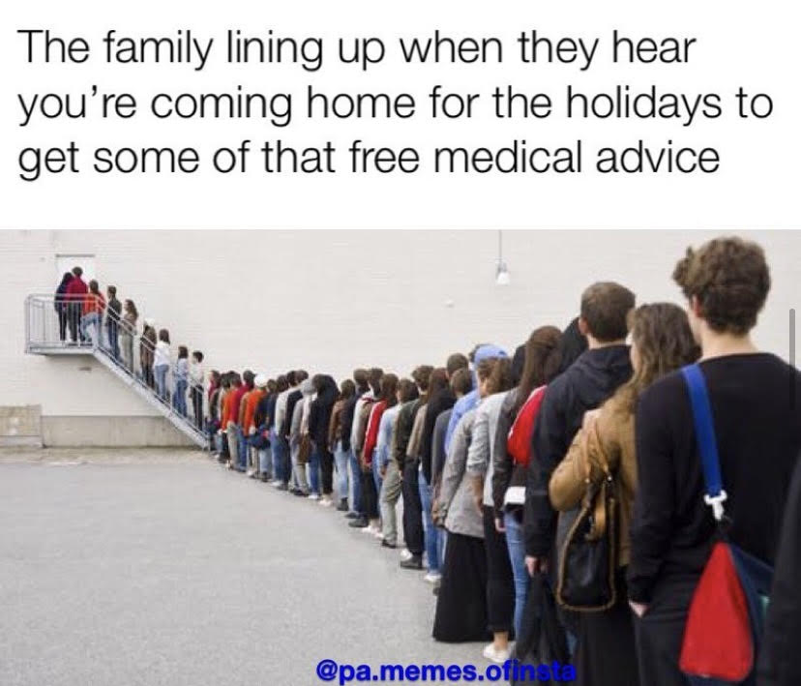
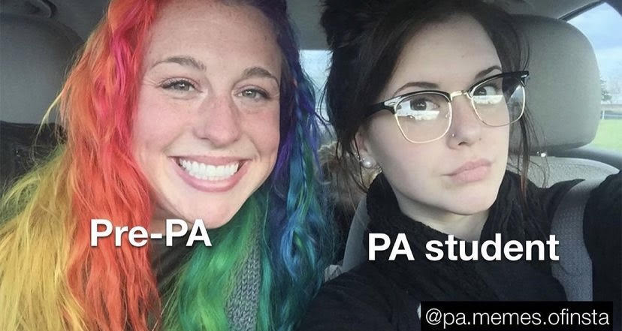
PPAA Student Panel
UF PA-S1

Slide 2
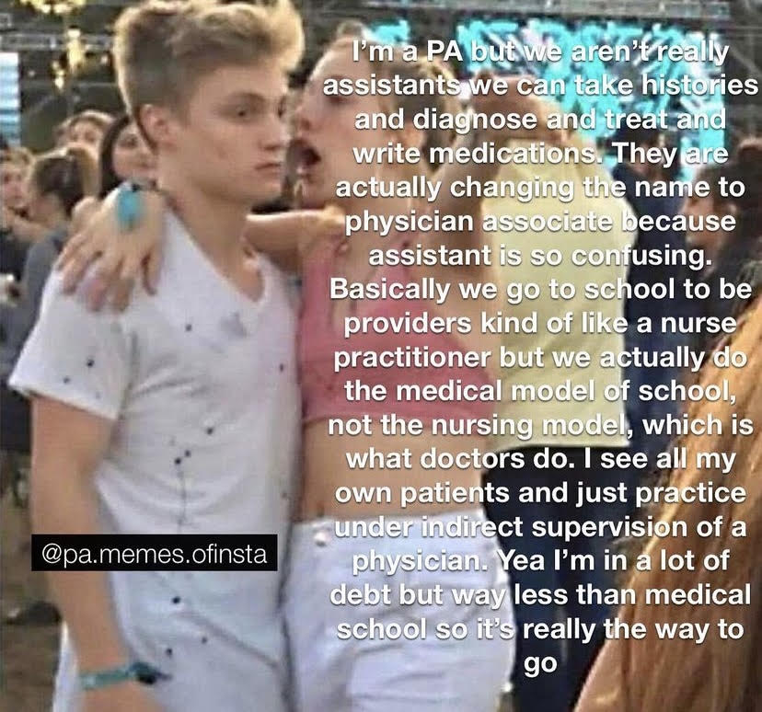
How do you
become a PA?
PA School averages 27 months
Didactic Year
Clinical Year
Masters Program
PANCE Certification
Recertification every 10 years

Slide 3
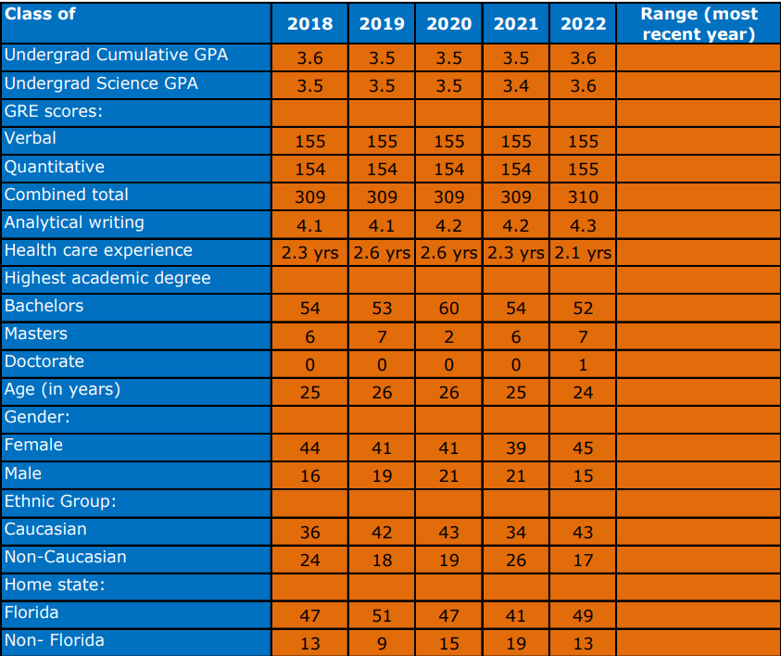
UFPA Class Profile
Requirements
sGPA: 3.0
GRE: 300
PCE: 2000 hours
Courses
  Anatomy and Physiology
  Microbiology
  General Chemistry
  Statistics
  Medical Terminology

Slide 4
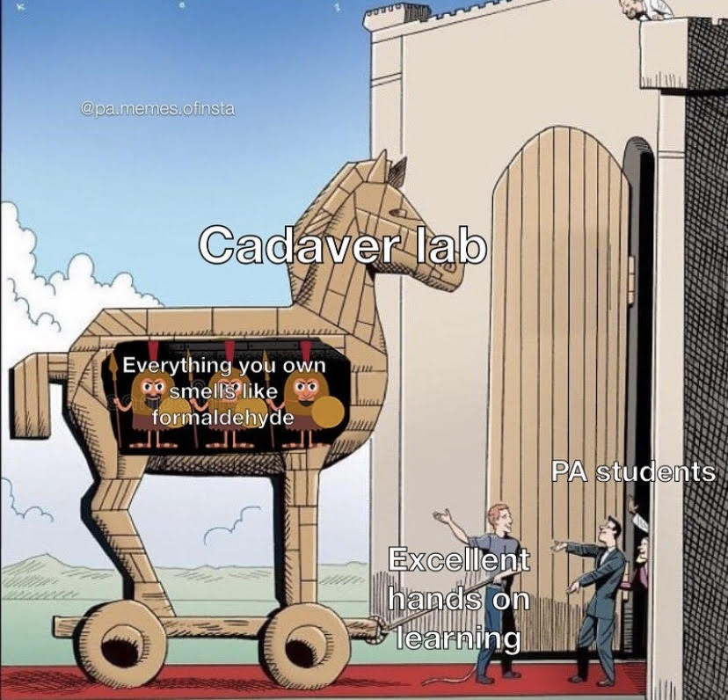
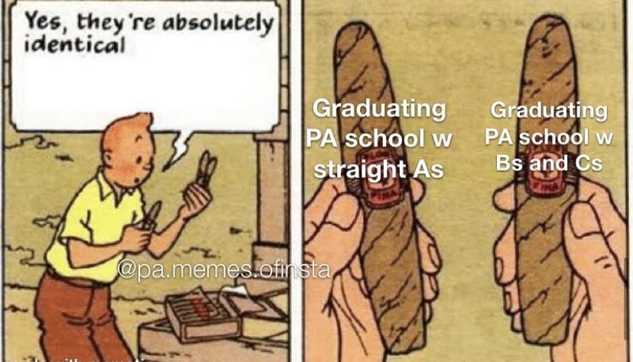
Cool things about UF PA
50 Years of UF PA!
24 month program
Anatomy Lab
Pass/ Fail courses
HMEB
PFF
EAC
Very supportive staff
60 students per class
LAC/ Simulation Lab
#22 PA School by US News

Slide 5
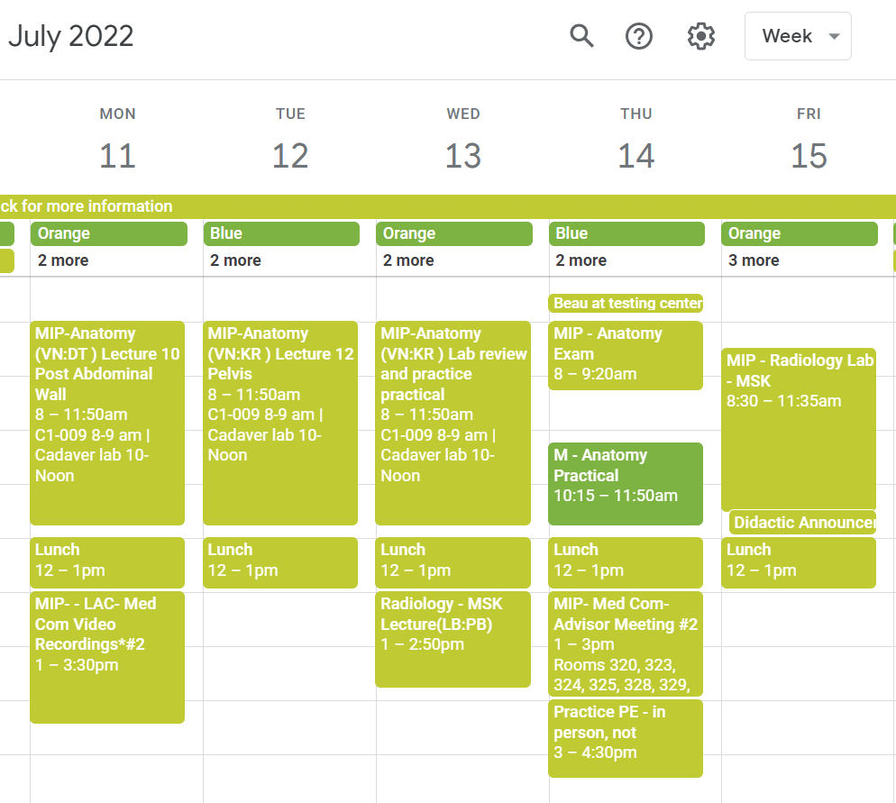
Day in the Life- S1 Summer B
3 classes: Anatomy with Cadaver Lab, Radiology, and Medical Communications
Roughly 8am-3pm
Anatomy Exams every 3 weeks

Slide 6
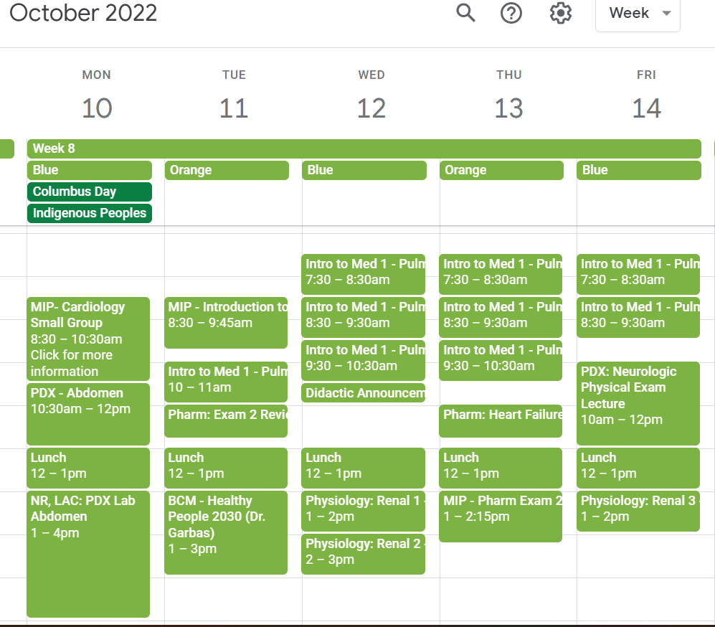
Day in the Life- S1 Fall
5 classes: Pharmacology, Introduction to Medicine, Physiology, Physical Diagnosis, and Behavior and Community Medicine
Weekly Exams
Physical Diagnosis Lab
Roughly 7:30-3pm everyday

Slide 7
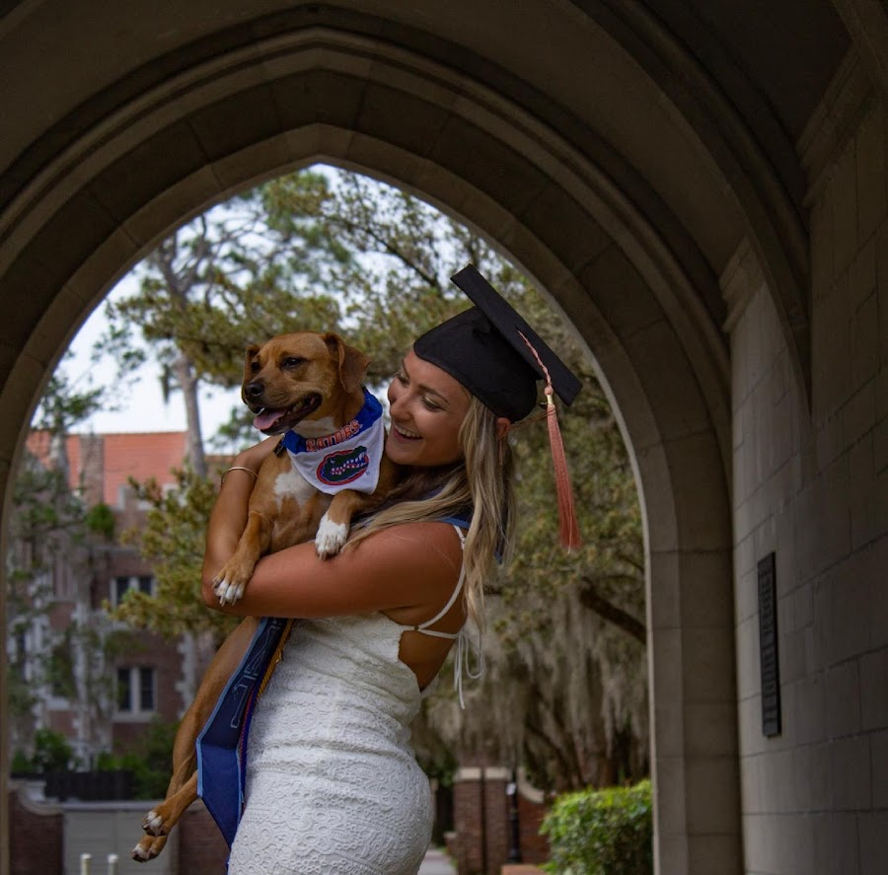
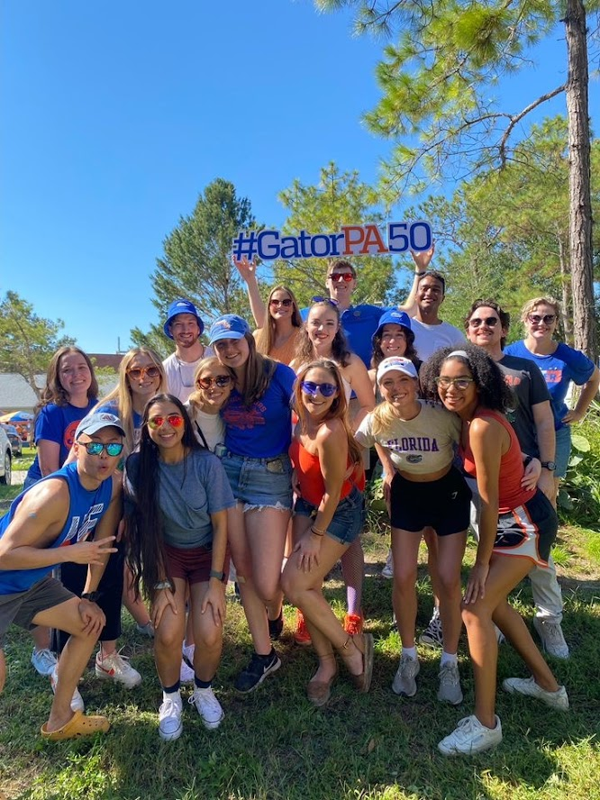
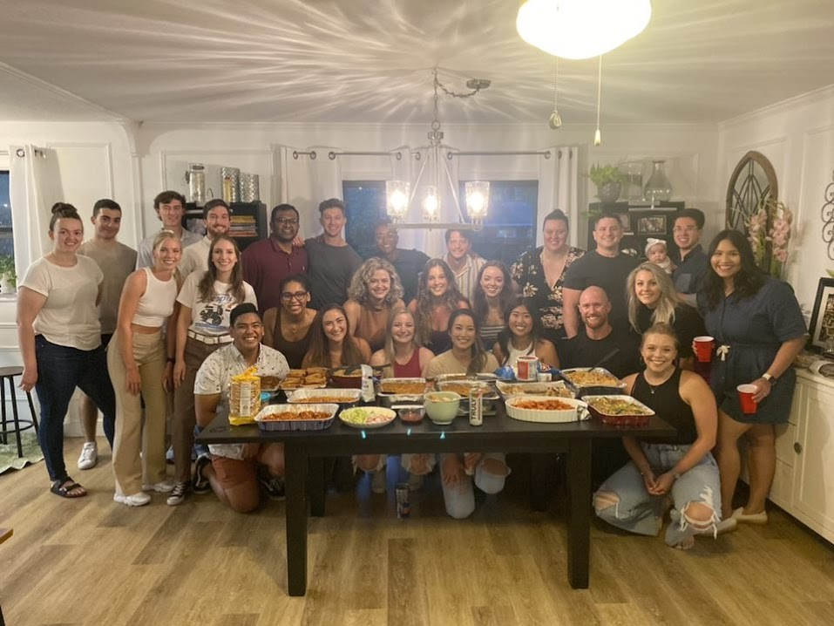
Morgan Vandall PA-S1 UF Class 2021
GPA: 3.76
Science GPA: 3.61
GRE: 310
Major: Health Science &
Behavioral and Cognitive Neuroscience
Application Yays
1200 hours MHT/ CNA UF Health Shands Psychiatry
1880 hours MA/ Surgical assistant Dermatology (320 hours at time of application)
Shadowing experiences with 2 PA’s and an NP
Volunteering with UF Health Shands Psychiatry
Volunteering and Leadership with MentorGNV
O’Neill Scholarship winner
CNA and CPR/AED Certified
Application Downfalls
Second time applicant
Withdrew from Calc 2
Did not take PA-CAT

Slide 8
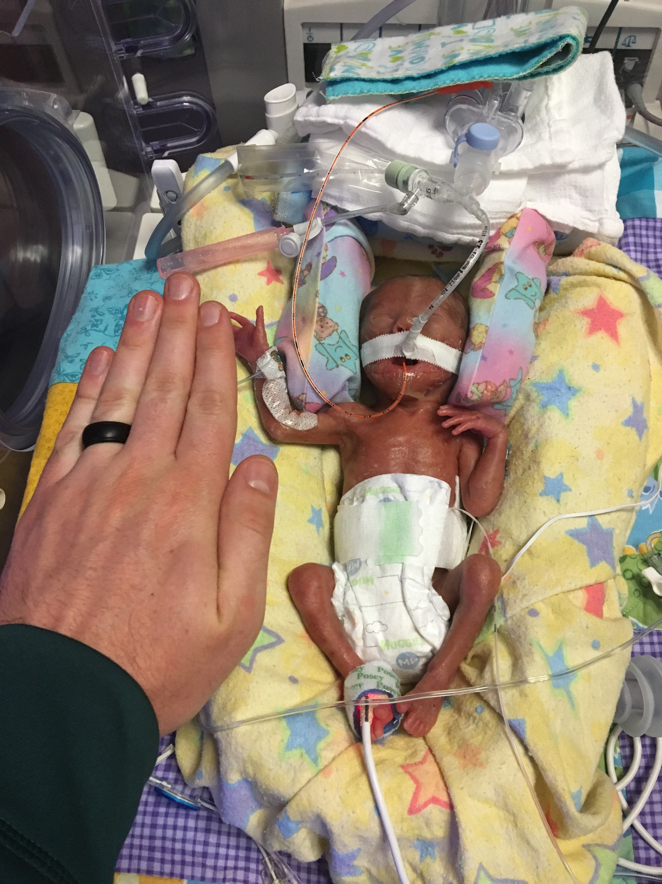
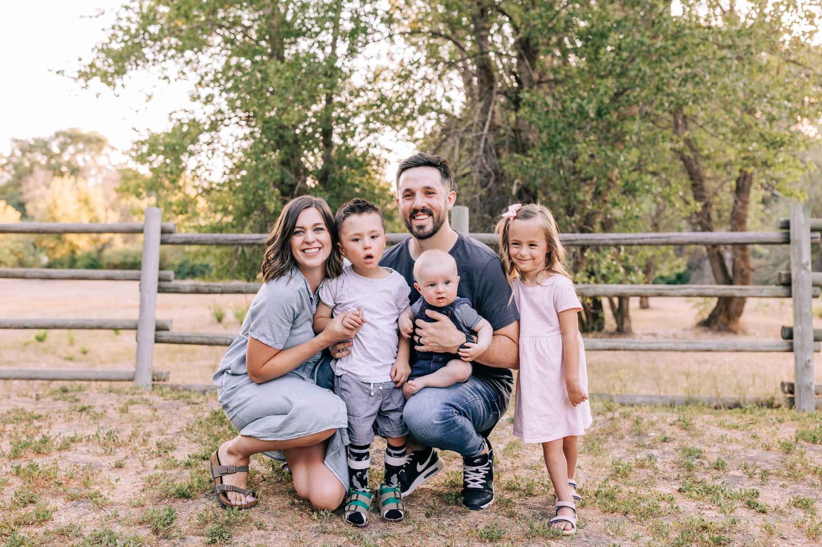
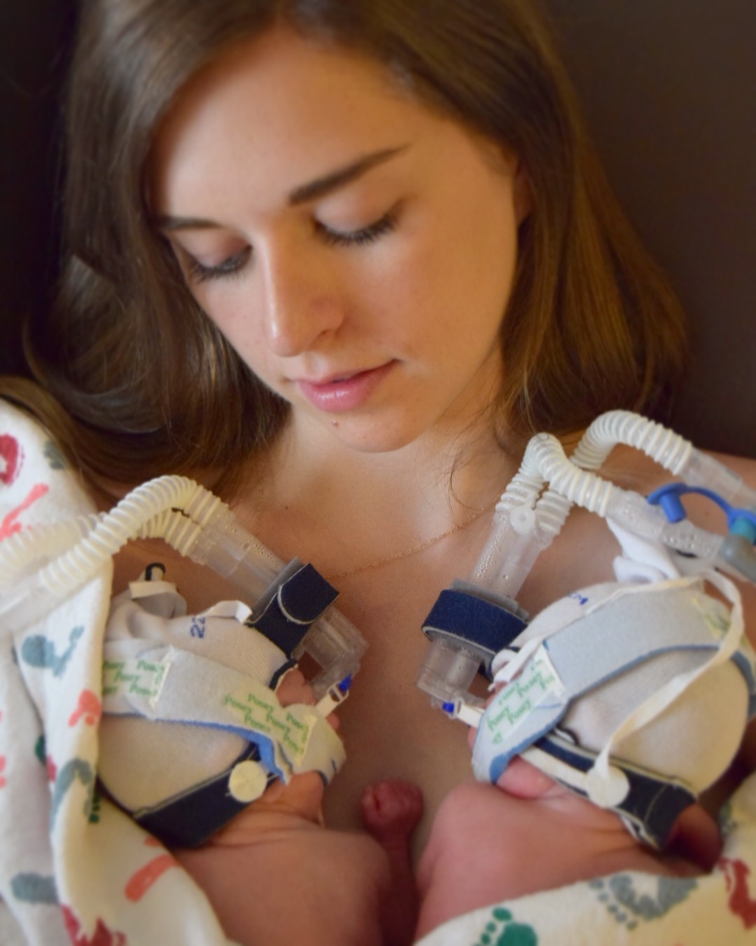
Charles Young PA-S1 UF PA Class 2024
Baccalaureate GPA: 3.34
Post-Baccalaureate Science GPA: 3.99
GRE: 313 Writing: 5.0
Major: Spanish
Minor: Global Business & Literacy
I’m a 32 y.o. married guy with 3 kids.
I never dreamed of going to PA school during my undergrad.
Worked for a few years after graduation, planning to get an MBA.
Had micropreemie twins and was exposed to healthcare and changed my whole life so that I could make it to here.
I quit my great job, and started a new one as an MA in dermatology and started taking prerequisite classes to get ready to apply for PA school.

Slide 9
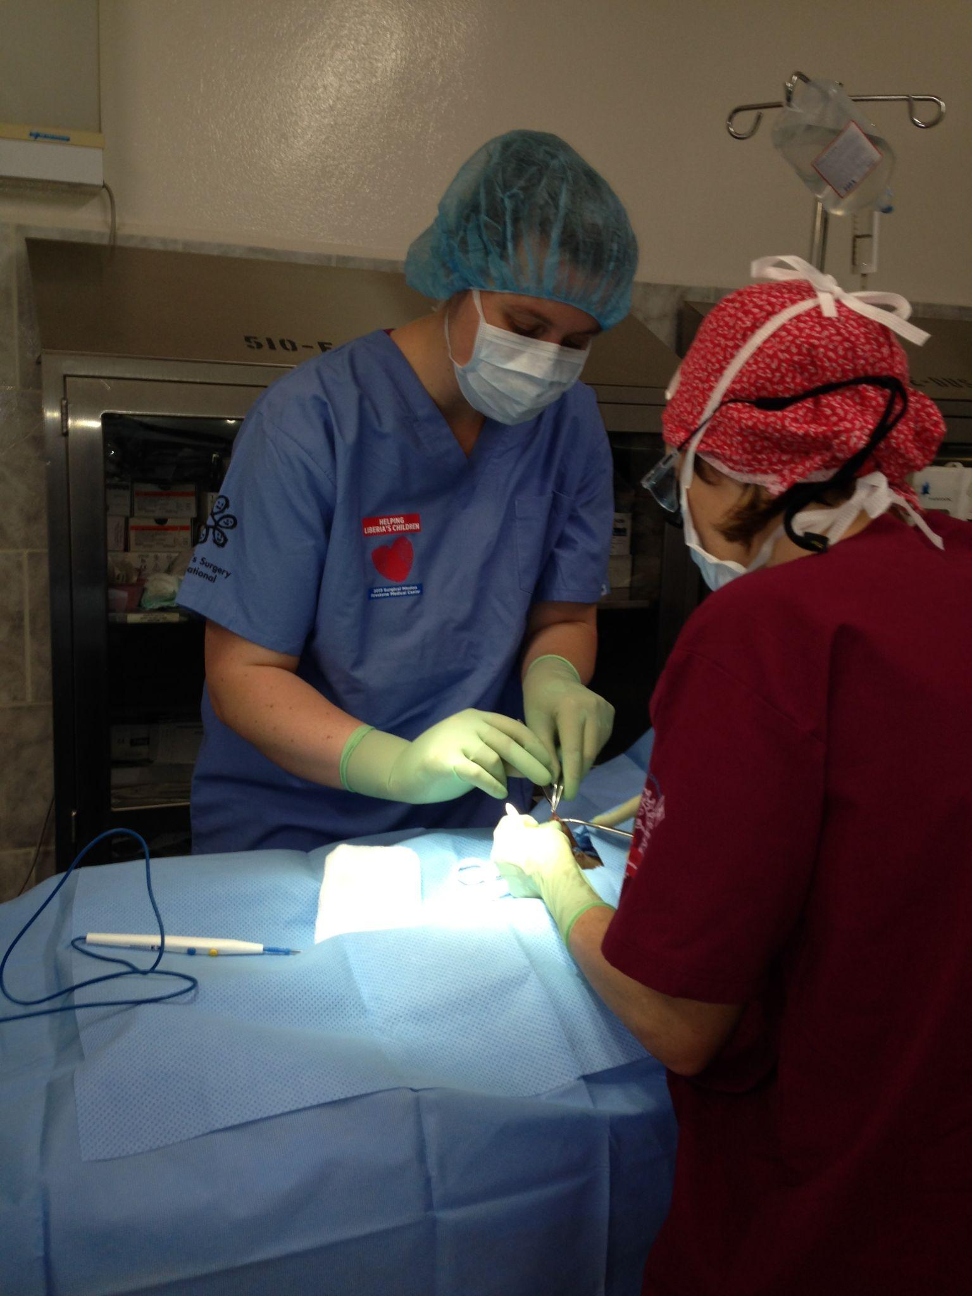
Kaitlin Nelson
Originally applied for a PhD in clinical psychology and Medical School
Decided MD wasn’t for me, did non medical related job
Still had a passion for medicine, PA was a much better fit
Decided to apply, got rejected due to lack of paid clinical experience
Strengthened my application for two years and got into ½ the schools I applied to the second time around
Clinical experience in ENT
SNAPSHOT
GPA
Overall: 3.60
Science: 3.79
Undergraduate: 3.41
Post-Bacc: 3.88
GRE: ~90 percentile
MEDICAL & MENTAL & PUBLIC HEALTH EXPERIENCE (HOURS)
Health Care (MA): 3,000+
Volunteer: 3,500+
Shadowing (live): 120+
Shadowing (virtual): 20+
Leadership: 800+

Slide 10
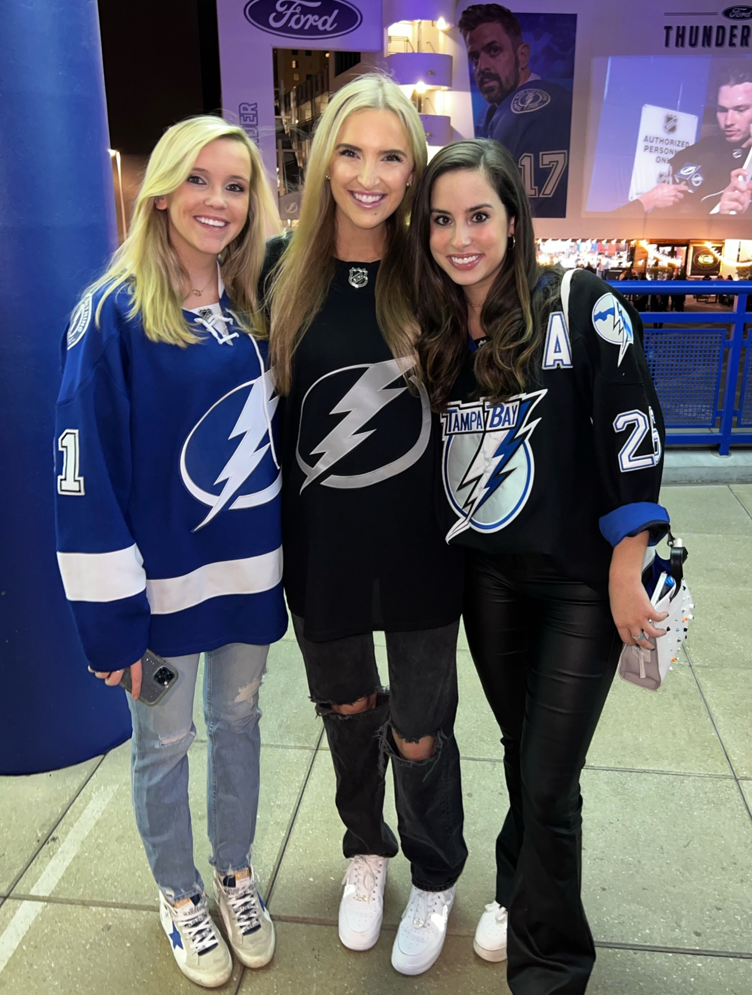
Hannah Stewart PA-S1 UF PA Class of 2024
Graduated from UNC in 2018, lived in NC working as a CMA then moved to Tampa in 2020
Majority of patient care hours in Derm
Didn’t get in first time applying, did a 1 year master’s program at USF to strengthen application
Worked at Moffitt Cancer Center while applying to schools
Majored in Biology & Political Science, GPA was good, GRE 320 Writing 6.0

Slide 11
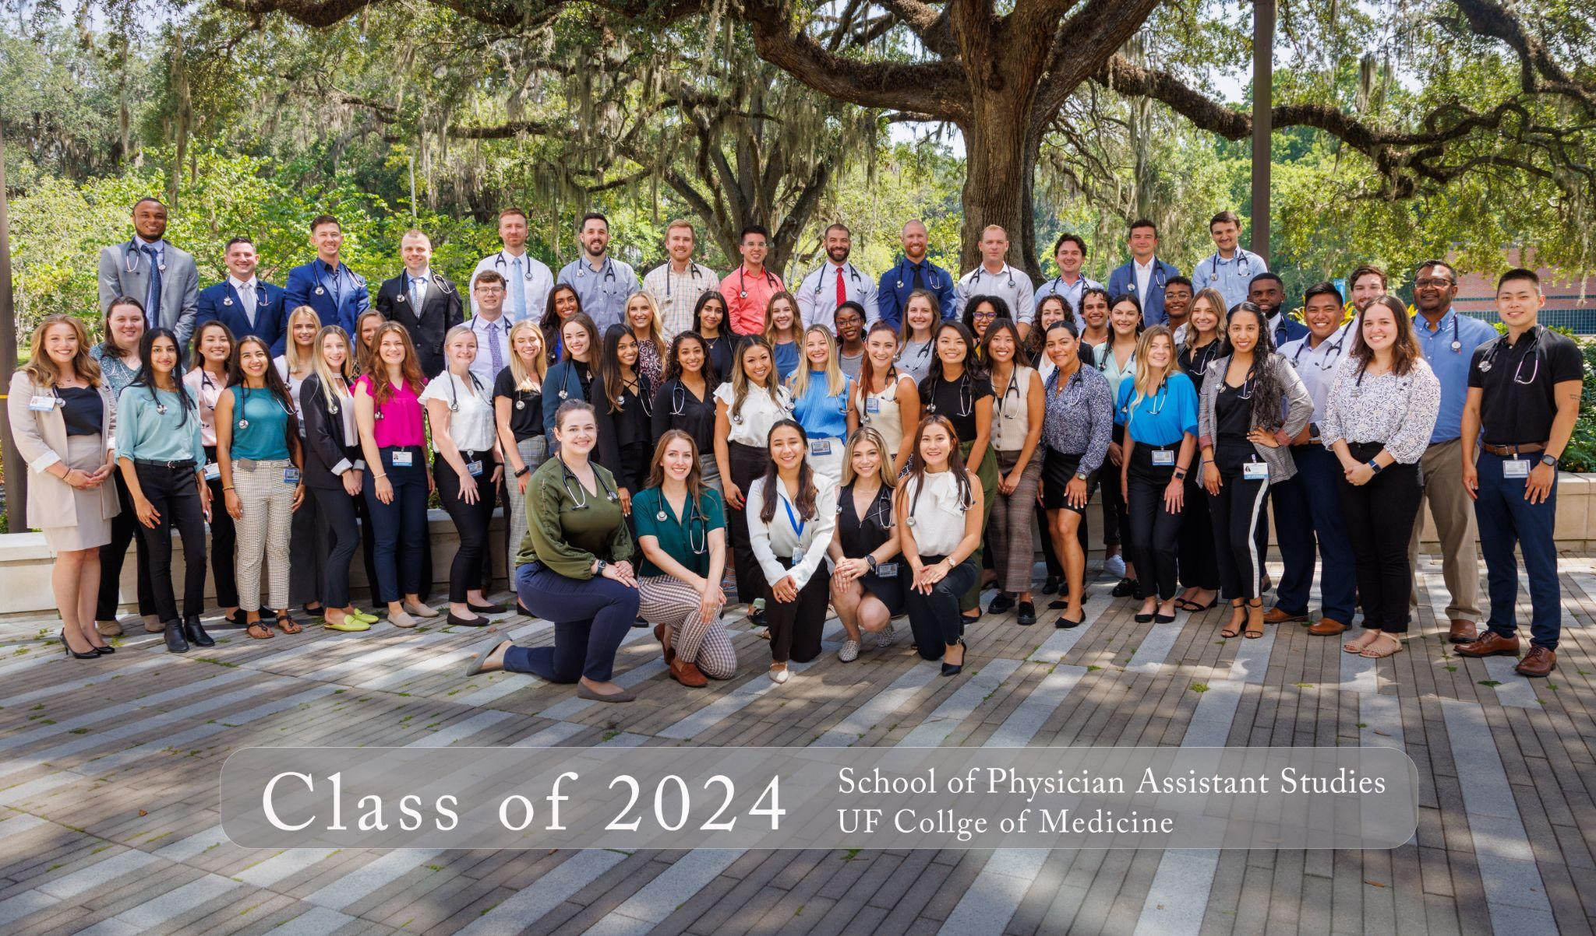
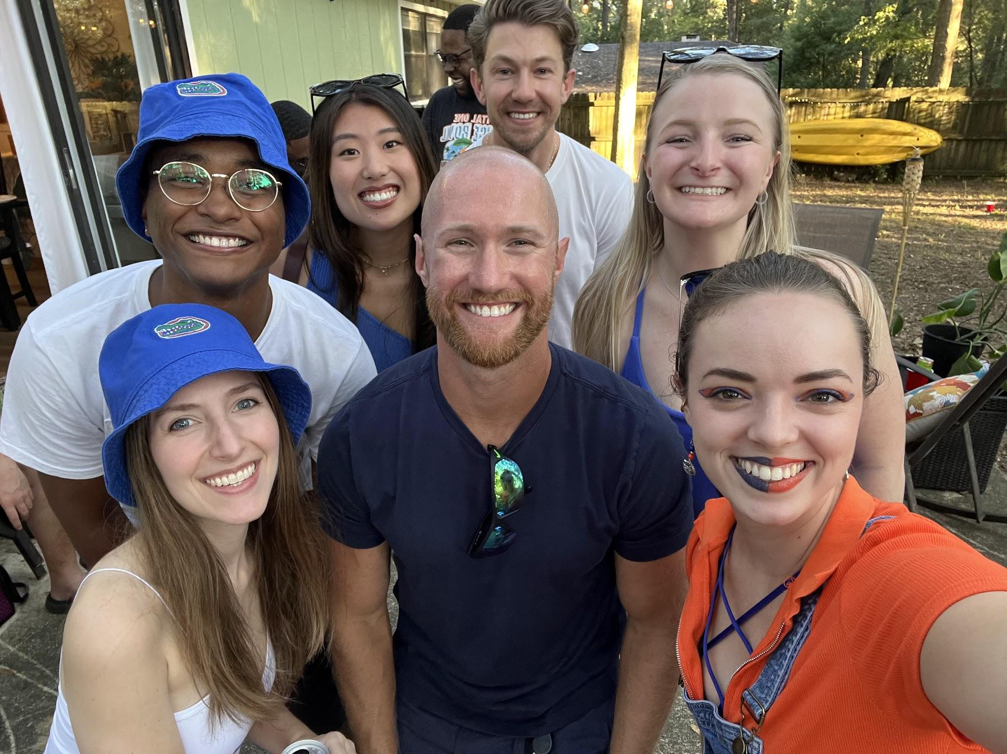
Jared Boyette PA-S1 UF PA Class of 2024
29 y/o, Florida born & raised
Graduated w/ B.A. in Business Admin 2013
Attended EMT, FF, & Paramedic school (2013-2015)
Paramedic officer (LT)/firefighter since 2015 working 2-3 jobs (ER, AHA-I)
Graduated w/ B.S. in Healthcare Admin 2020
PA has been my goal since I went back to school in 2019 to be able to provide for my future family.
Initial GPA was a 2.8 (2013). I didn’t know what I wanted to do with my life yet and didn’t care about grades.
From EMT school through the end of my second bachelor's, I put in the effort to keep all A’s to end up at an overall of 3.5 non-science and a 3.7 science GPA

Slide 12
Tips For Pre-PA!
Get patient care experience from more than one location.
  You don’t want to hop around, but having a lot of hours in more than one field of medicine gives you an advantage in PA school and a well-rounded application
Look for opportunities for leadership, shadowing and volunteering early
  Everyone has a different journey but there is no such thing as starting to soon
Research what prerequisite courses are required for each program early
  Schools have a large variety of what they require (ie. General Chemistry vs Language Course vs Biochemistry)
When applying to programs look at PANCE pass rates, matriculation rates and use resources to hear current students experiences
  You want to find the program that is right for you!

Slide 13
How to Contact Us
Morgan Vandall
  mvandall@ufl.edu
Charles Young
  charles.young@ufl.edu
  (801) 694-9012
Kaitlin Nelson
  (650) 815-5692
  @kaykuls24 (Instagram)
Hannah Stewart
  hgstewart6@gmail.com
Jared Boyette
  jaredboyette@ufl.edu
Sweatshirts order: https://www.b-unlimited.com/products/reorder-university-of-florida-physician-assistant-studies-crewneck-pr-hanes-f260-sweatshirt-ash

