Slide 1
Physician Associate Journey
Leon Jin Chen
MPAS, PA-C

Slide 2
Disclosures
I am not paid to speak at any conference or panel. Everything I do say is my opinion as well as knowledge.
I am honest with my answers, but I will not answer any questions about pre-requisites, that said, do not be afraid to ask questions (publicly or privately).
Everyone's journey to PA school is entirely different! The most important lesson is making the most of it!

Slide 3
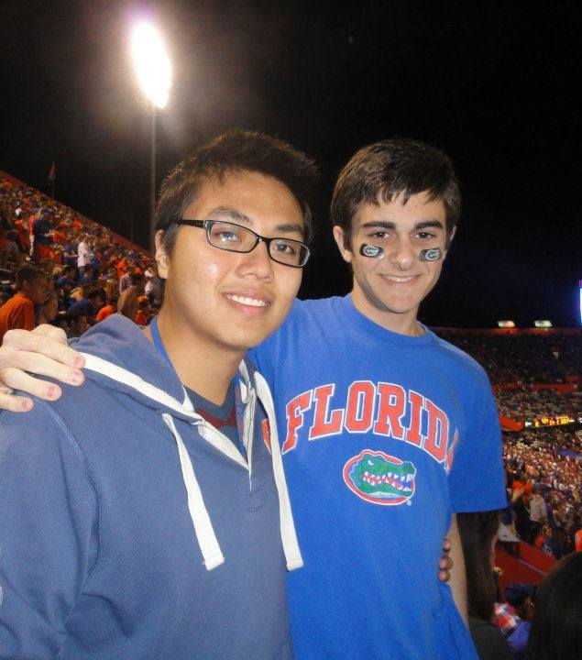
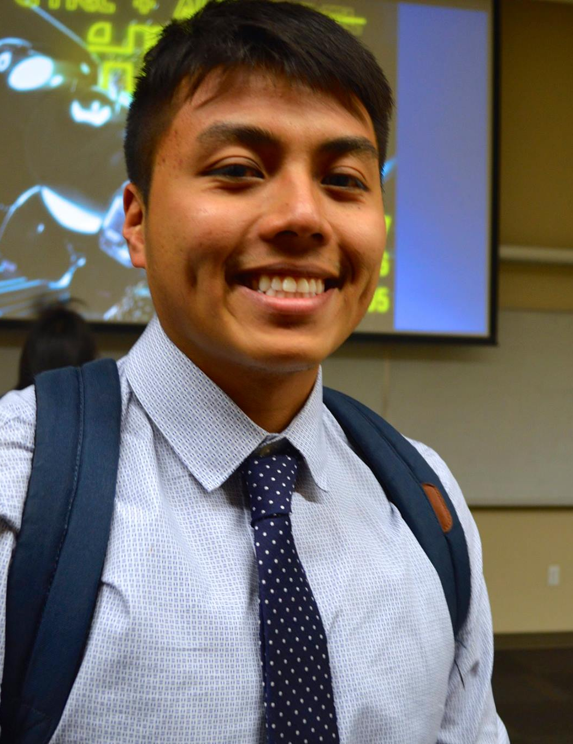
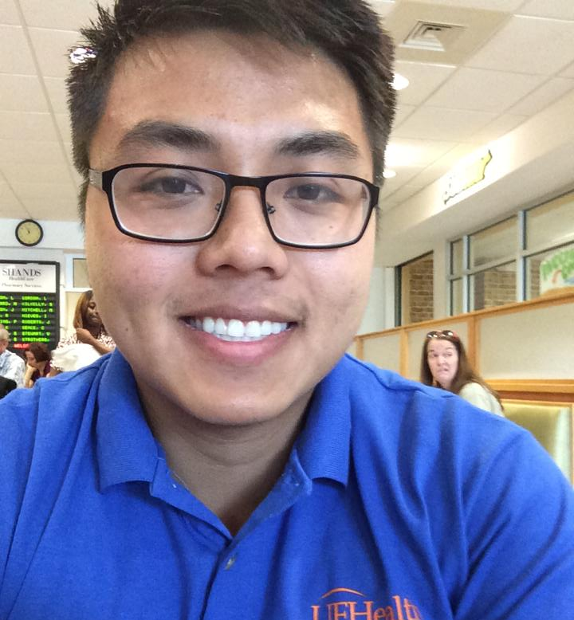
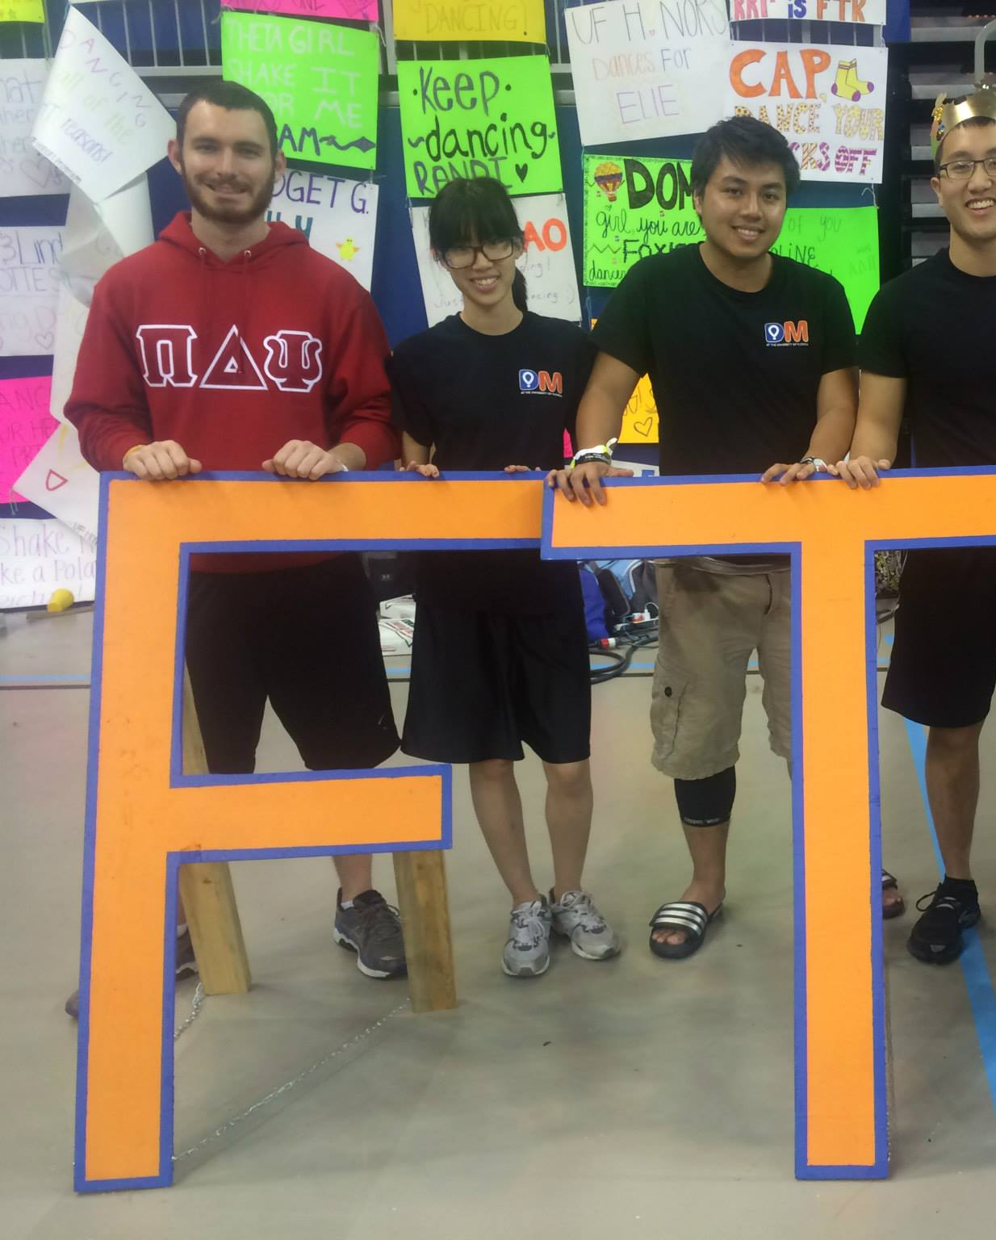
University of Florida Undergraduate Life
Enjoy it and make the most of it!
Hands down of the best experiences I can remember.

Slide 4
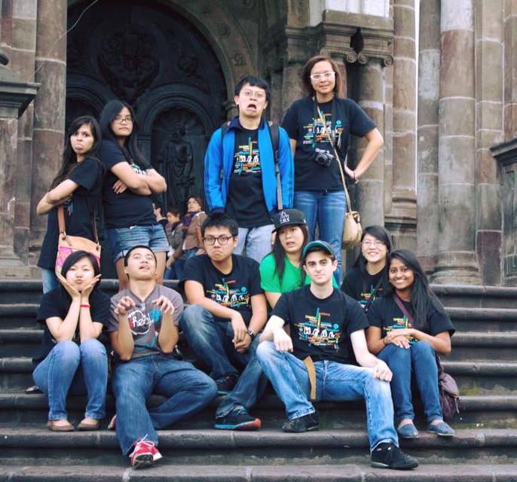
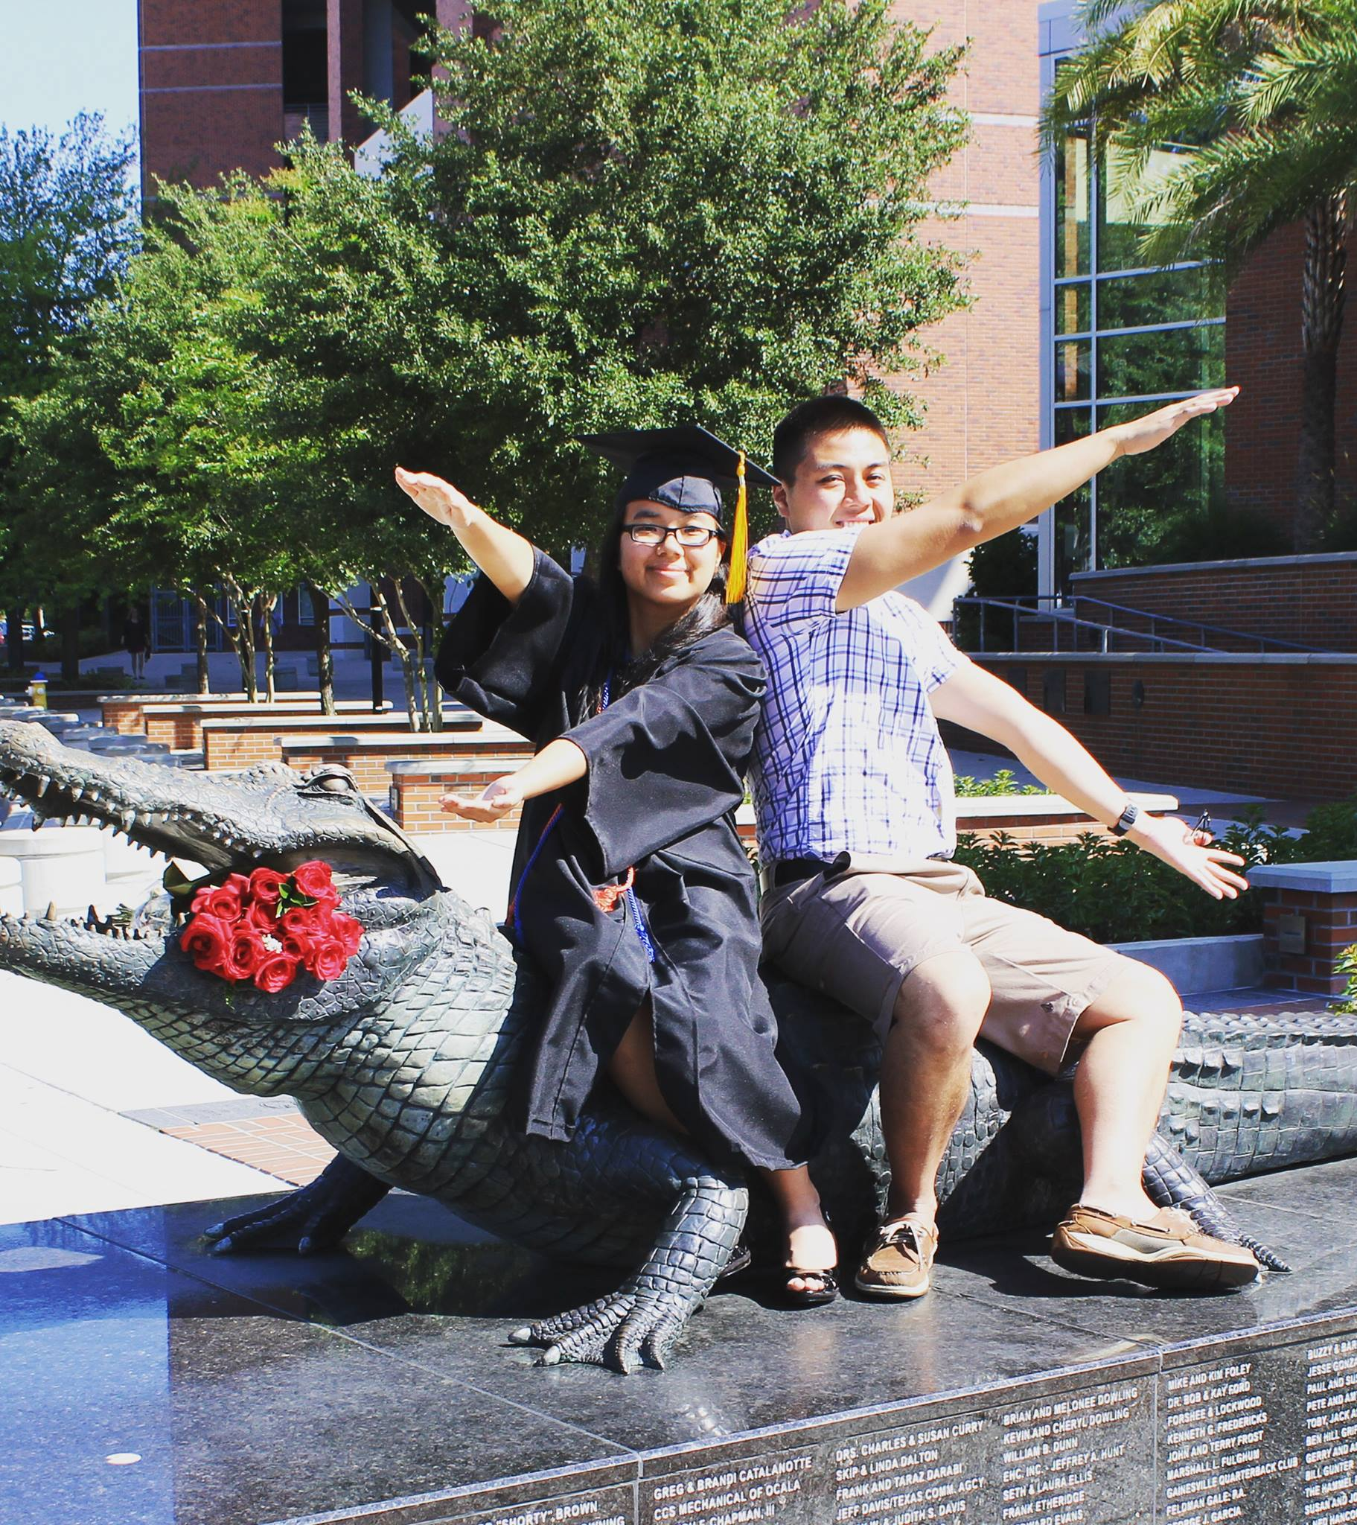
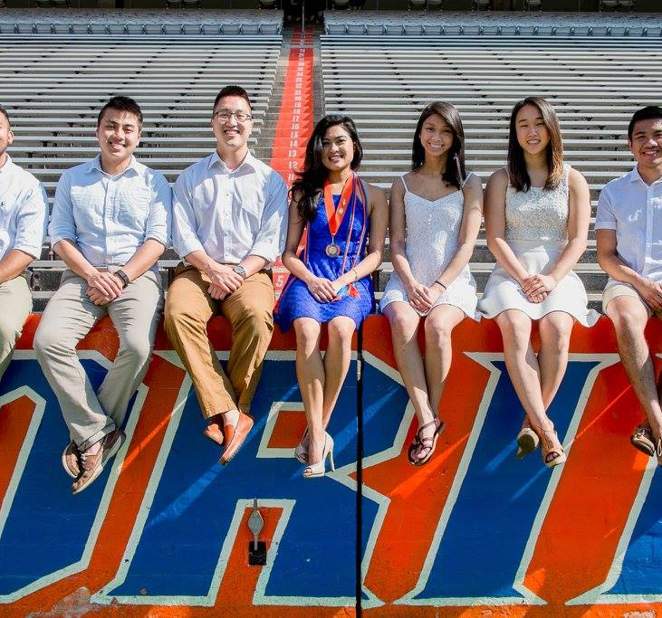
More Undergrad Photos
Enjoy.

Slide 5
Statistics
First Generation Chinese American
UF Class of 2014 with Bachelors of Science in Microbiology
GPA: 3.8, Science GPA: 3.9 - Magna Cum Laude
Typical Pre-medical track

Slide 6
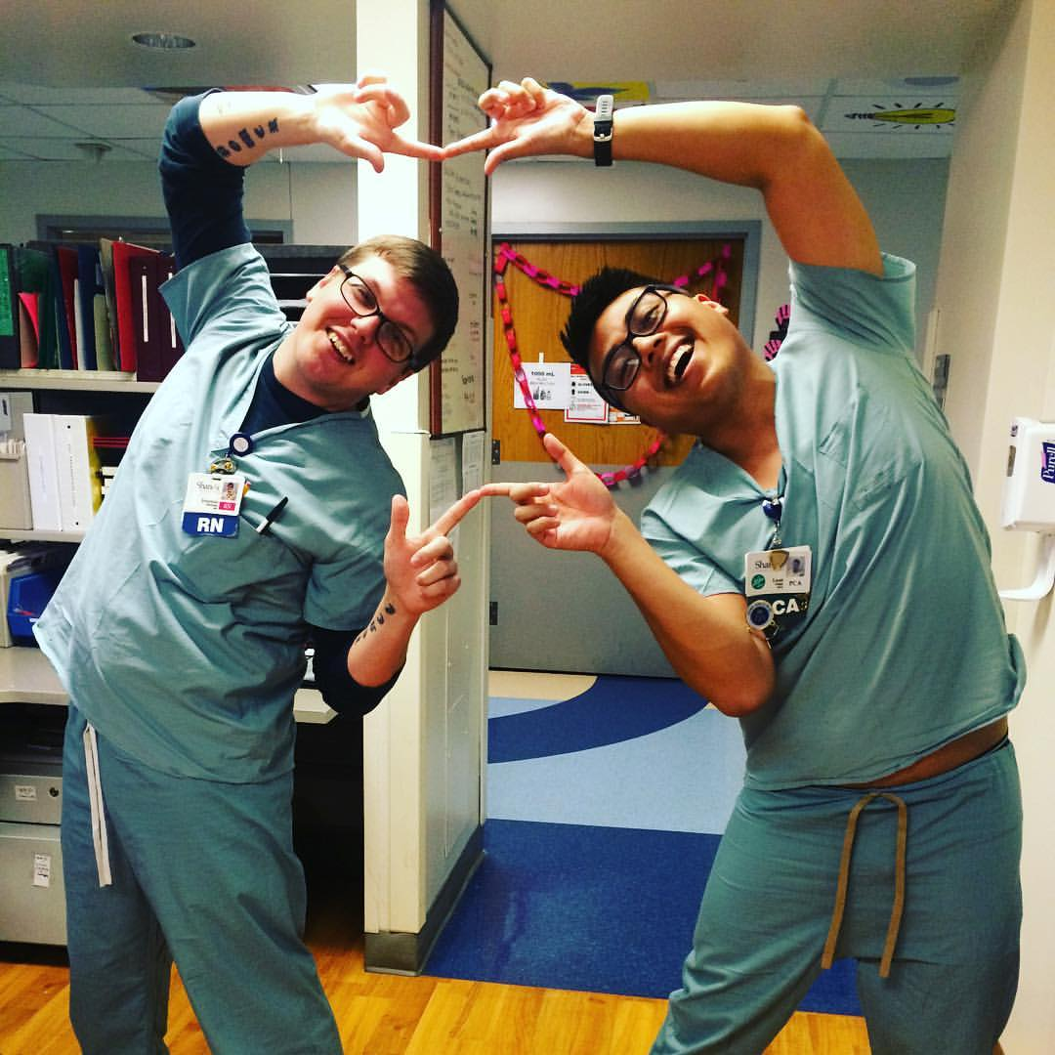
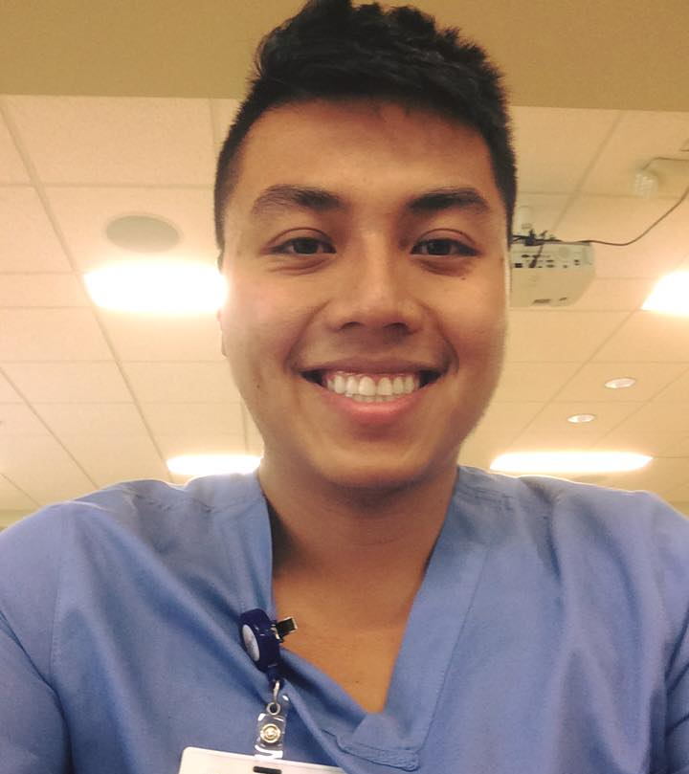
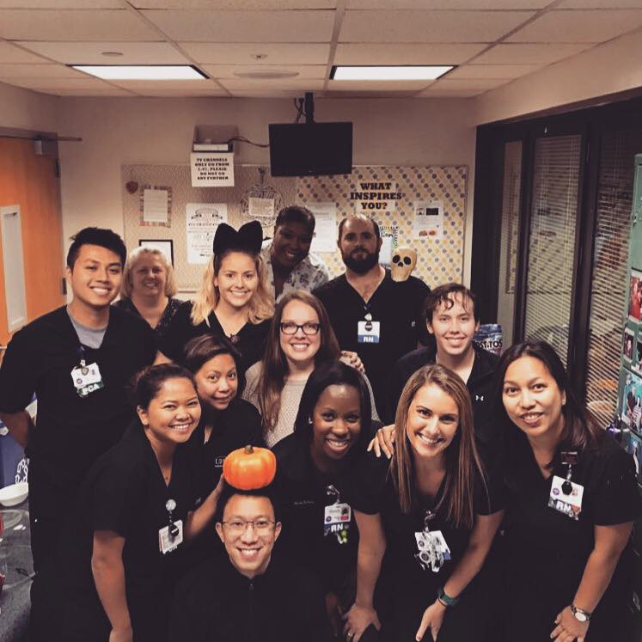
Patient Contact Hours
Patient Care Assistant:
Nightshift on Unit 66 – Cardiac IMC/MS
Over 4,000 PCE Hours

Slide 7
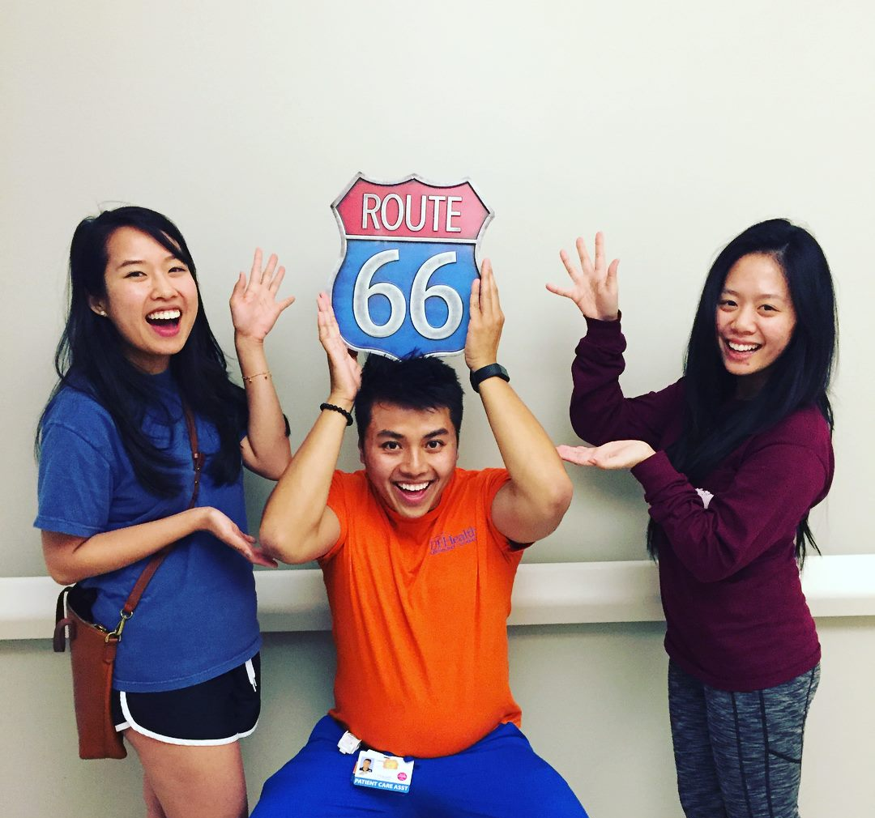
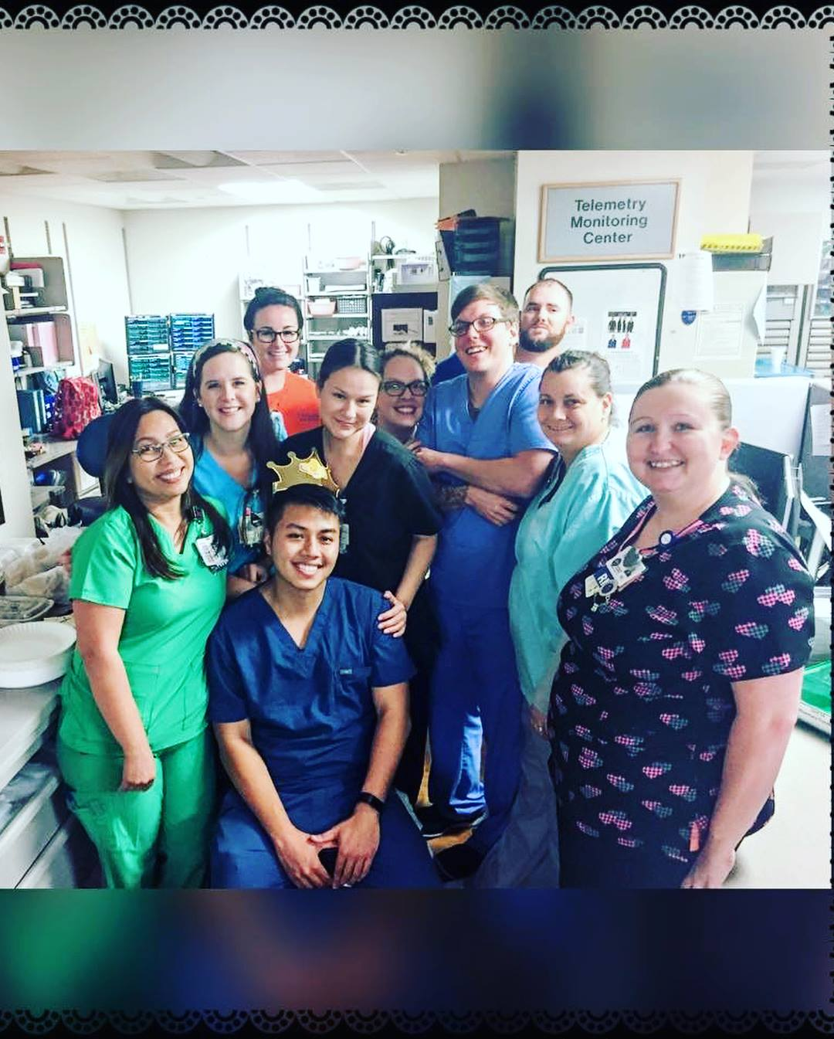
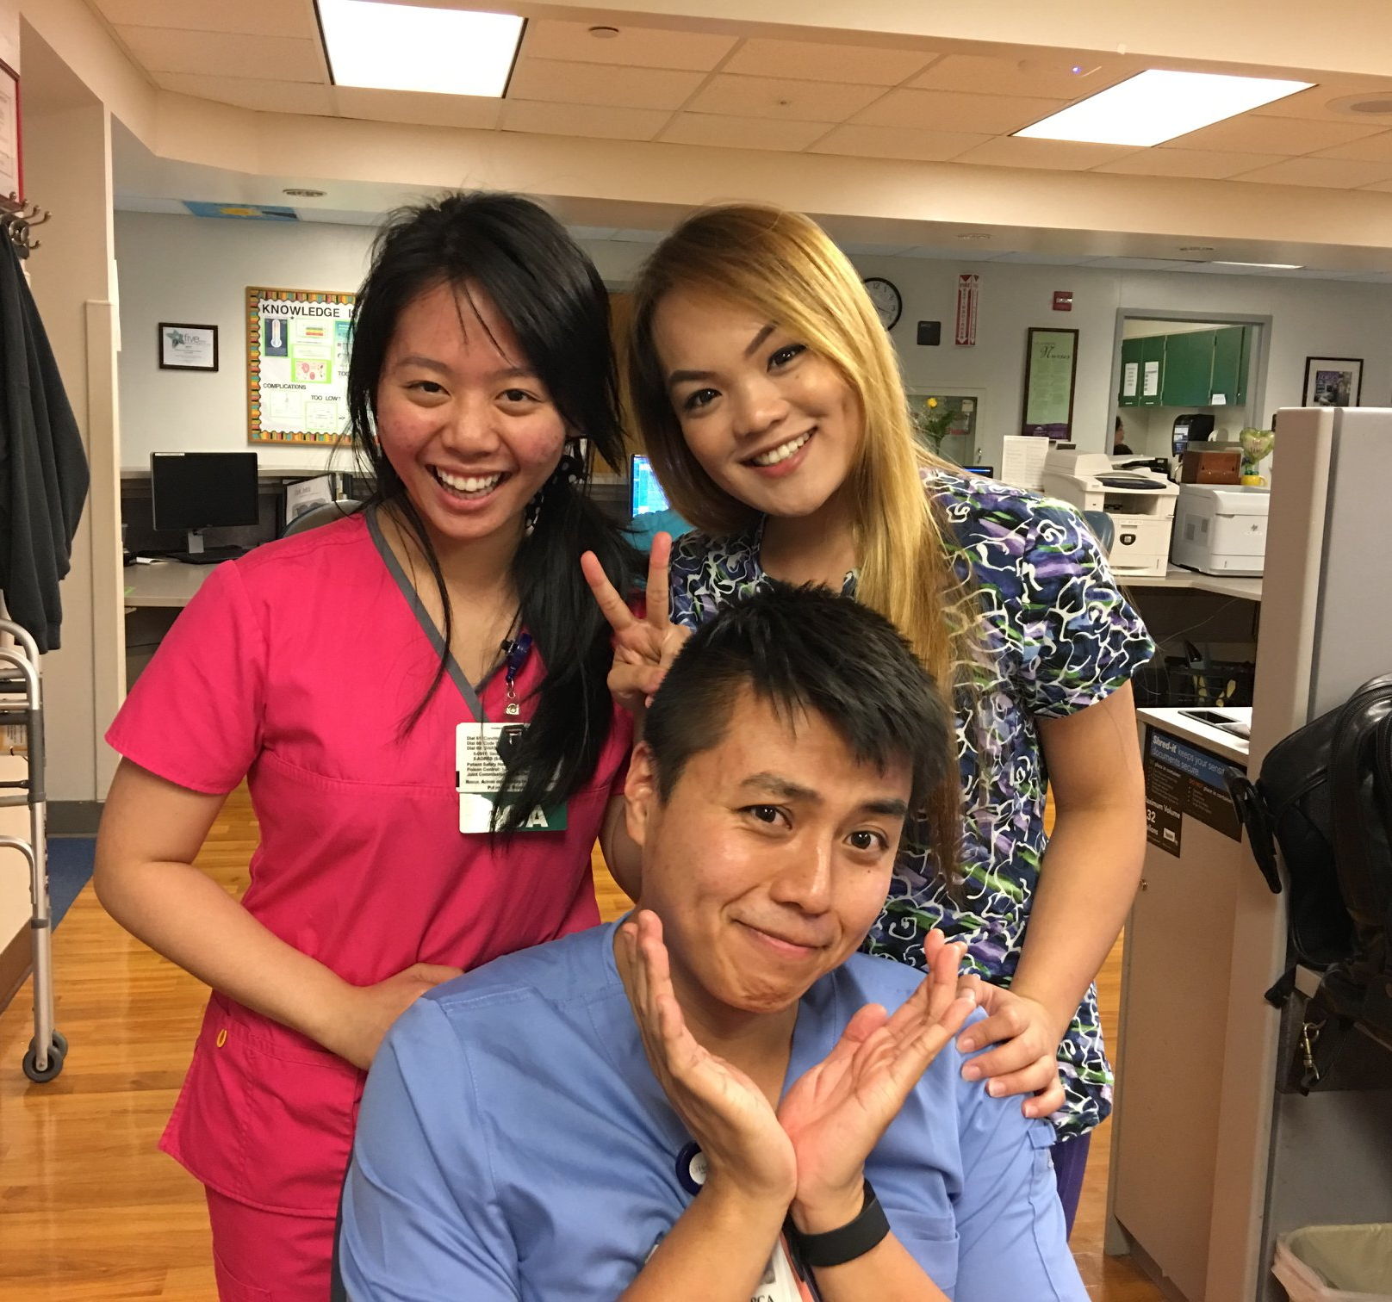
Growth Year Photos
Night Mafia Family

Slide 8
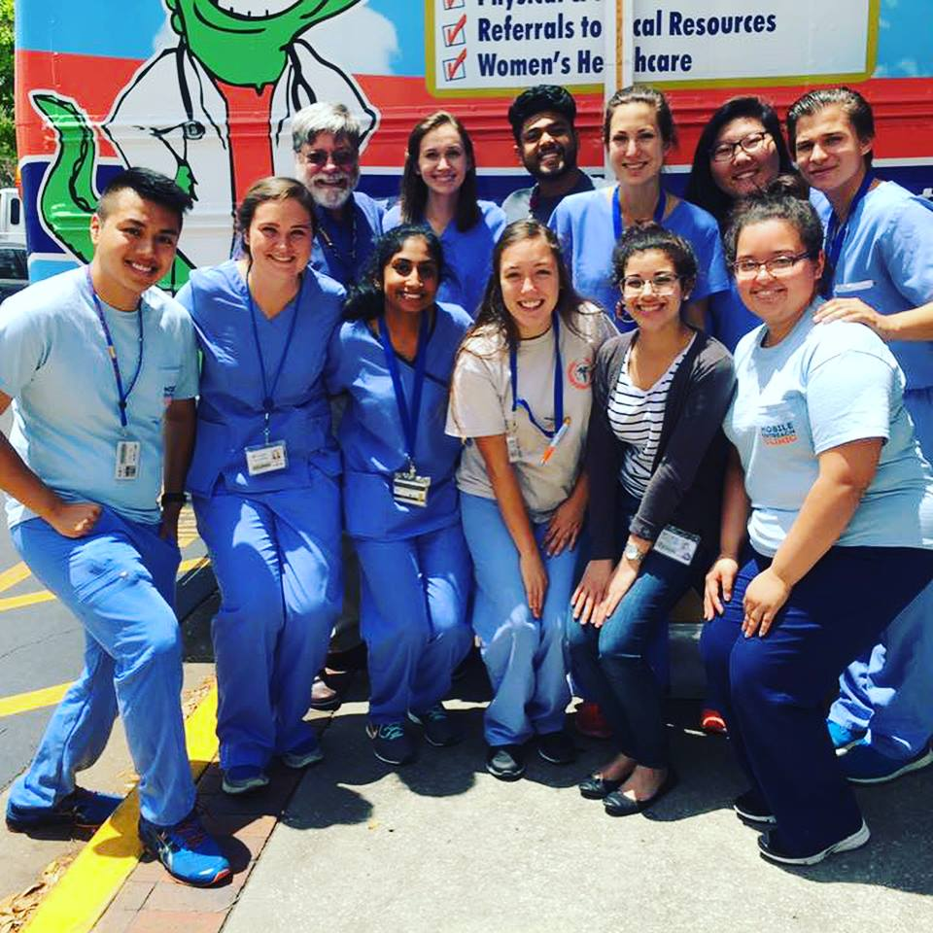
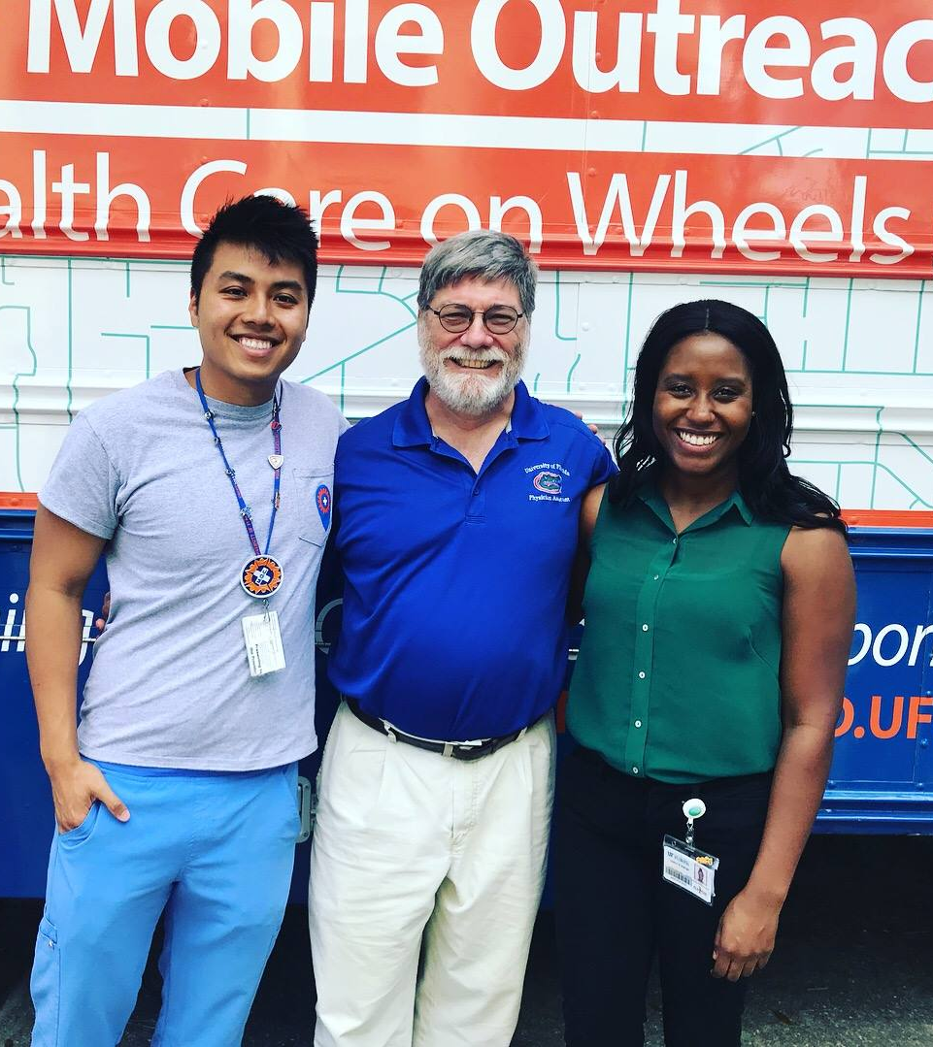
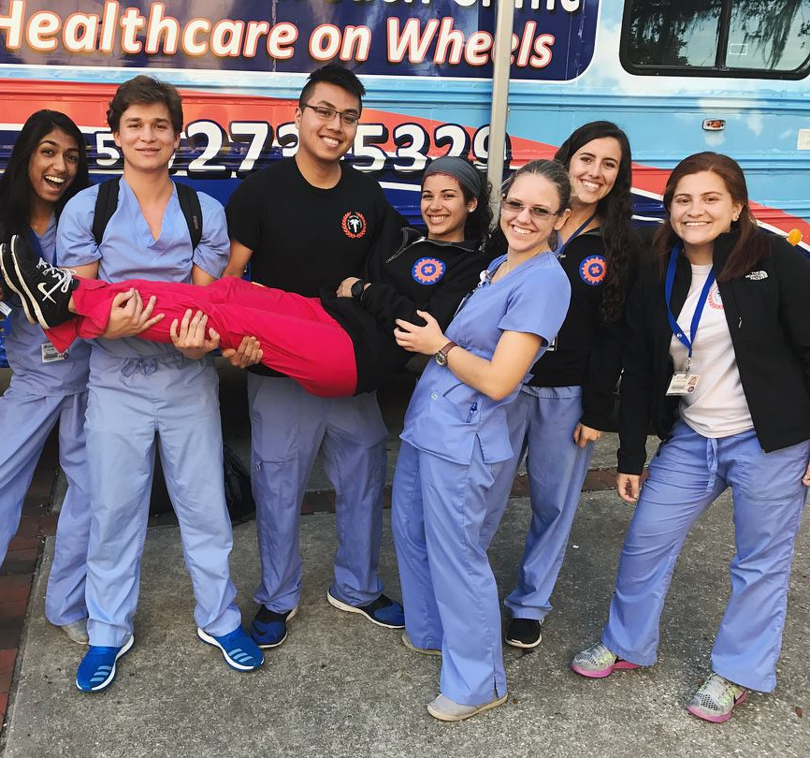
Mobile Outreach Clinic
Volunteer Hours: ~ 400
Medical Scribe
Care Coordinator

Slide 9
Application Process
Applied to CASPA in 2017; total of three growth years including the switch from pre-med to pre-PA
Total school applied: 15
Interviews: 7/14 (went/invited)
Accepted my offer to UF COM SPAS Class of 2020.
Double Gator

Slide 12
