Slide 1
Becoming a PA
Kathryn Allen, PA-C
Notes:
Disclosures

Slide 2
My Journey
Undergrad
Elon University, class of 2013
Major: biology
Minors: psychology, neuroscience
Post-Bacc
Additional courses
Community college
PCE Job
Moved to NC
Duke Hospital Float Pool CNA
Applying to PA School
Started in 2016
Notes:
Born and raised in MD
Moved back to MD after graduating – took additional classes (orgo and psych), started looking for PCE job
Moved to NC for job, also shadowed and volunteered

Slide 3
My Application Timeline
3-time applicant
Accepted to PA school in October 2018
Notes:
Applied for the first time in 2016
Multiple interviews each cycle; final interview and acceptance in October 2018

Slide 4
PA School
Started PA school in July 2019
Campbell University
12 months didactic
12 months clinical rotations
Graduated in July 2021
Notes:
System-based integrated curriculum, cadaver lab, early clinical opportunities
4 week rotations x11, 2 electives

Slide 5
After PA school
PANCE in early August 2021
PA-C ~1 week later
Relocated to Gainesville, FL
Accepted job in March 2022
Started work in May 2022

Slide 6

PA School is Hard! But Not Impossible!
Notes:
Same thing with getting into PA school – challenging, but worth it! This is a marathon, not a sprint
Not all sunshine and rainbows, like social media
But also not studying 24/7 with zero life

Slide 7
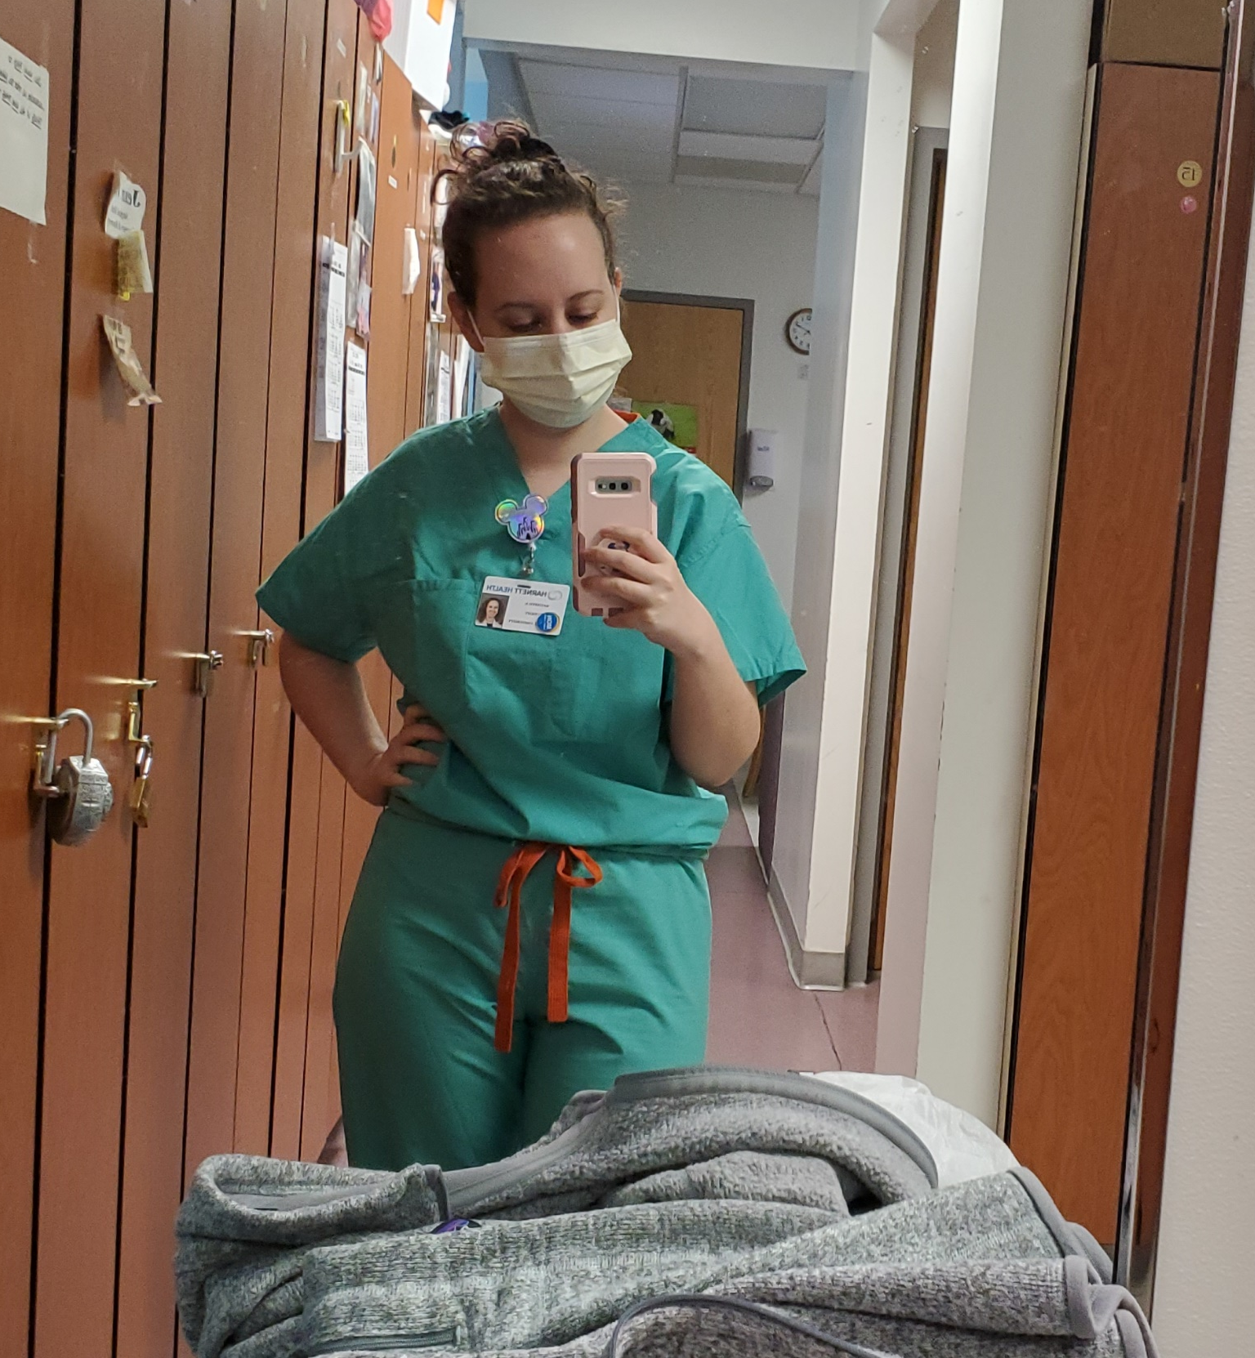
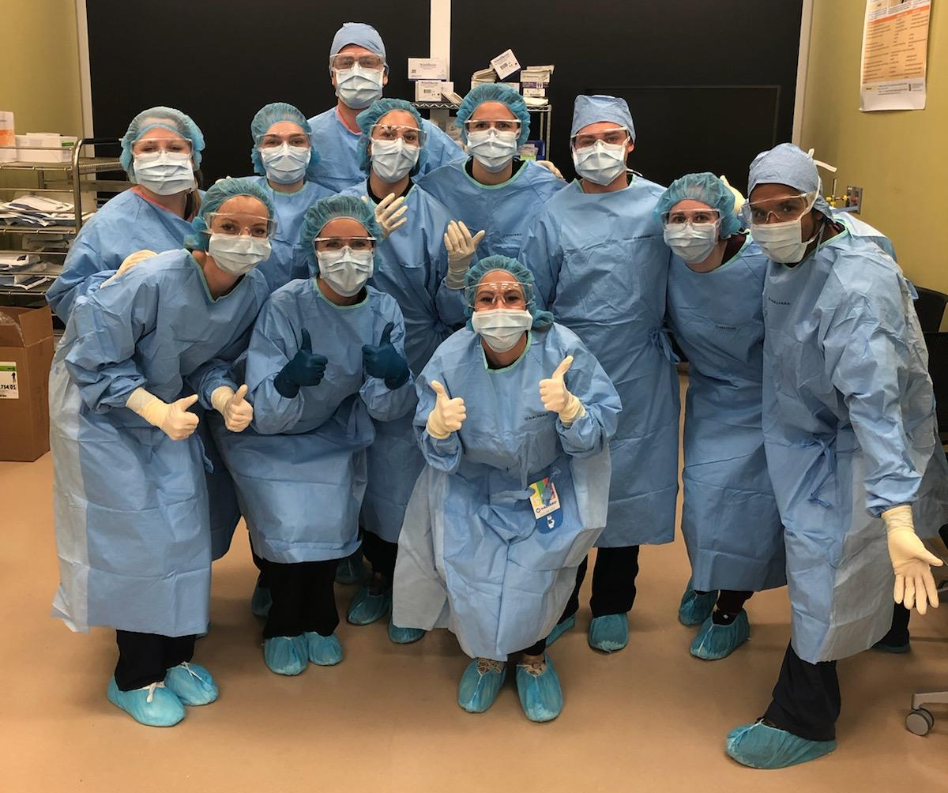
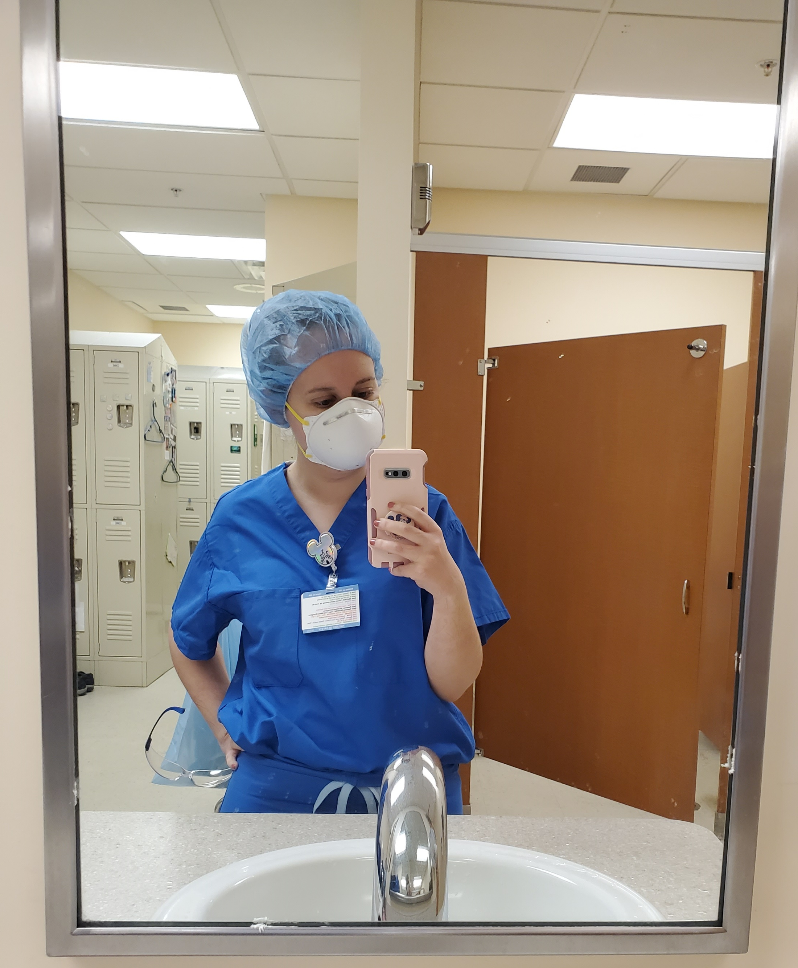
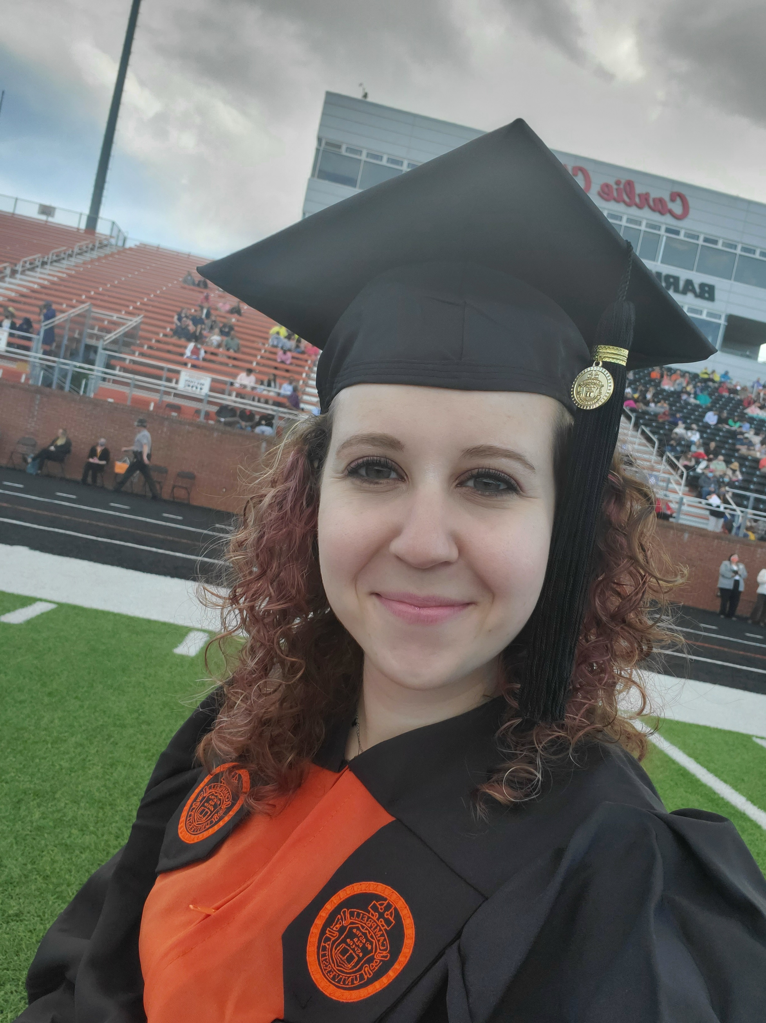
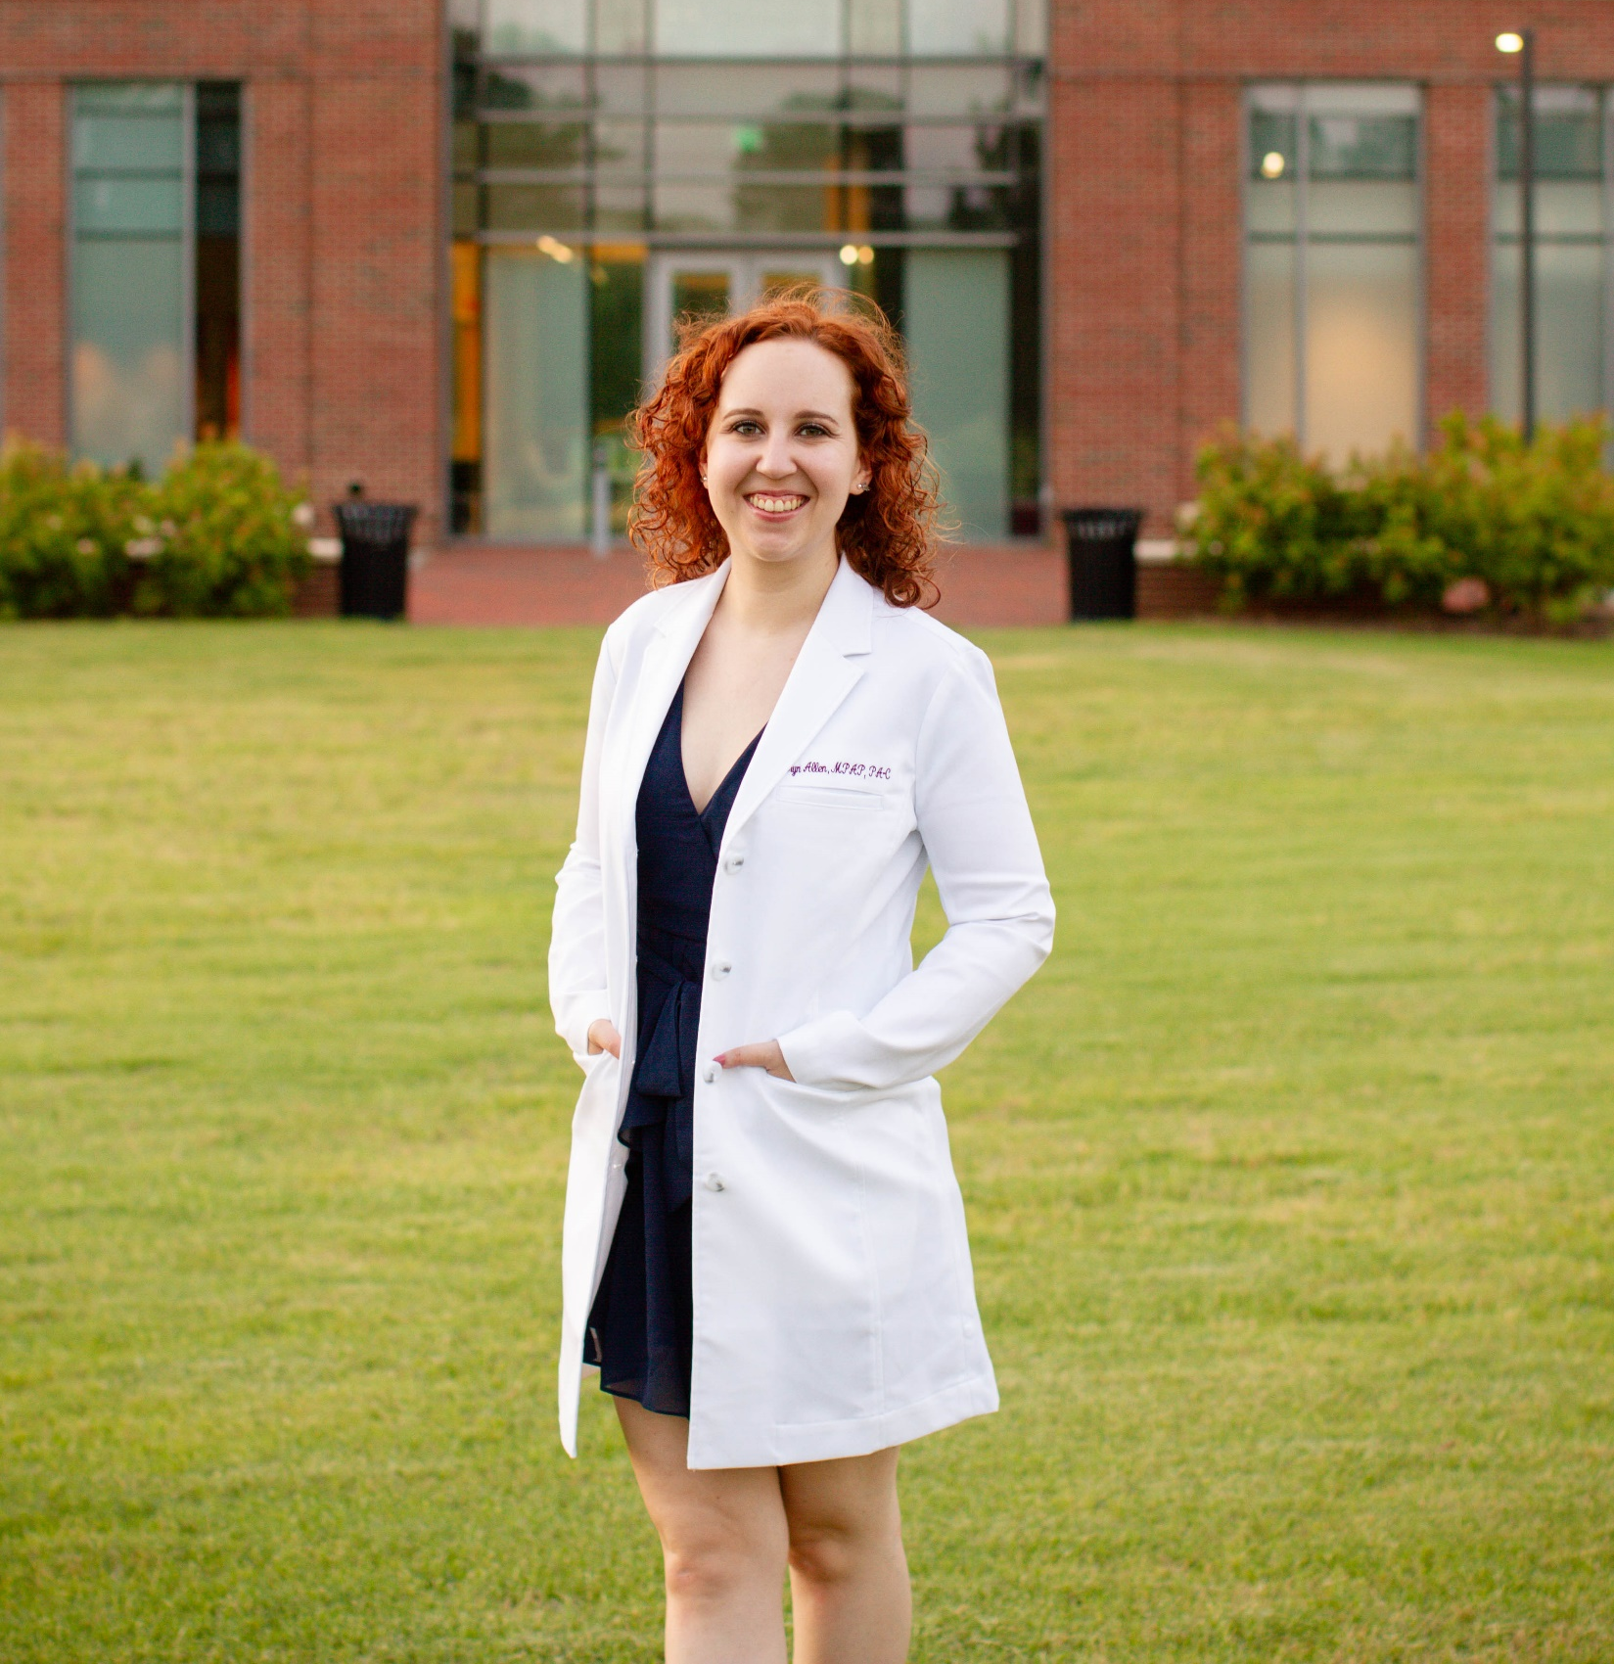
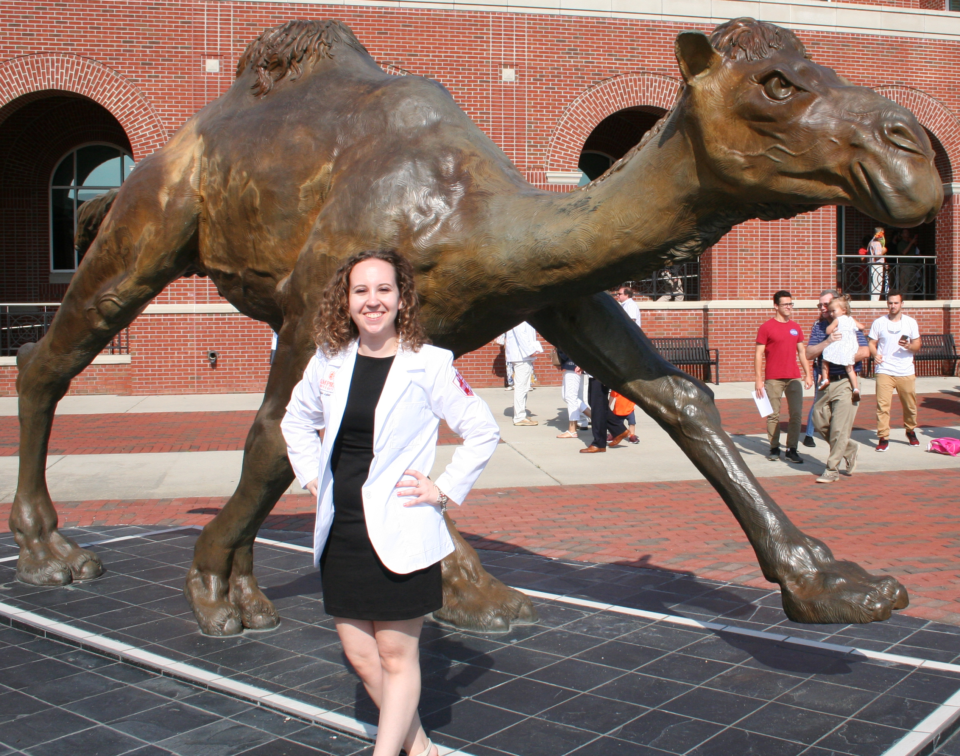
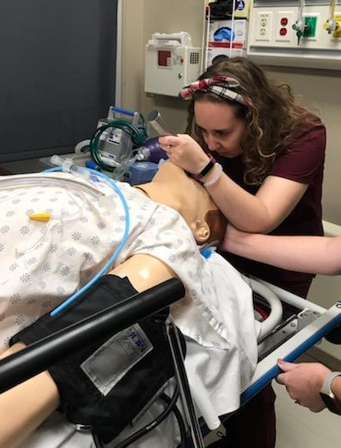
Notes:
Learned how to intubate, helped deliver babies, scrubbed into surgery, held newborn babies, took care of thousands of patients

Slide 8
Why PA?
Less schooling
Lateral mobility
Team aspect
Notes:
Started applying to PA school at 25; started PA school at 28
Lateral mobility – don’t have to choose
Team aspect – didn’t care about being “the boss” or being called “doctor”
*Don’t say work-life balance

Slide 9
“Gap” Years
Not a fan of this term
No right or wrong path
Notes:
Not a fan of this term – implies they are a waste of time
Nothing wrong with going straight to PA school; nothing wrong with waiting
Gap years are a great way to gain experience (both professional and life), save money, and take a break from school
Class age range = 22-48yo

Slide 10
Being a Reapplicant
3-time applicant
Not uncommon
Learn from each cycle
Improve your application
Notes:
It is not uncommon to have to reapply (only ~25% of applicants start PA school)
Go into the process expecting to have to reapply
Learn from the cycle
Always be working to improve your application; don’t wait for rejections

Slide 11
Applying to pa school
Do your research
Start your personal statement early
Don’t compare
Apply early
Keep track of your information
Don’t let it consume you
Notes:
Research – location, requirements, mission, opportunities, faculty/facilities, rotations
PS – brainstorm/free write first, have multiple people edit, reader should be able to determine the prompt
Don’t read forums or compare stats; so much more to application than statistics
Emphasize your strong points; find schools that fit your application
Apply early – especially if rolling admissions; by mid-June is best (by deadline only if not rolling)
Use Excel spreadsheets – track hours, organize school info, track school communication

Slide 12

Questions

Slide 13
Where to find me
Instagram: @pa_Kathryn
thepaplatform.com

